Slide 1
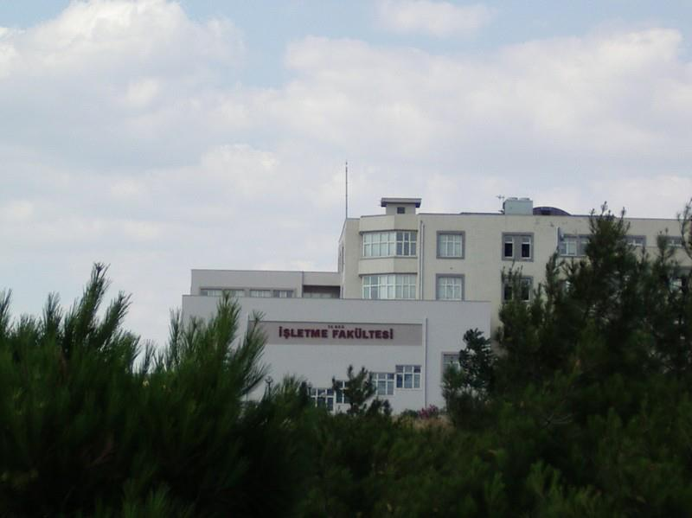
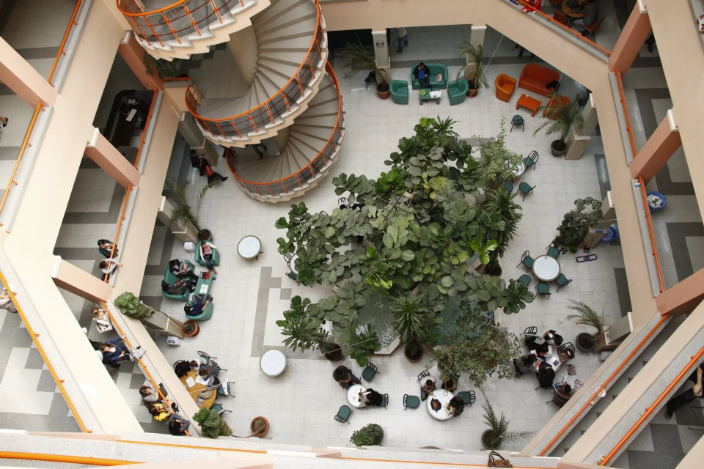
DOKUZ EYLUL UNIVERSITY FACULTY OF BUSINESS
İZMİR, TURKEY

Slide 2
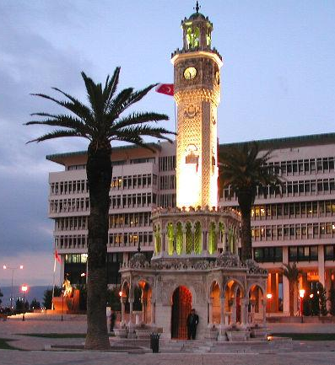
İzmir City
Has always been a great trade hub
Multi-cultural life style
8500 years old city, cradle of civilizations
Home to 8 universities
Close to touristic / historic places
Mediterranean climate

Slide 3
Dokuz Eylül University (DEU)
University was founded in1982
She is a city University with 13 campuses
Presently has 14 Faculties, 5 Graduate Schools, 6 Vocational Schools , 5 Institutes , 49 Research Centers and Technopark
Student population is around 53000
Academic and Administrative Staff population is 6800
Dokuz Eylul University is awarded with ECTS Label and DS Label

Slide 4
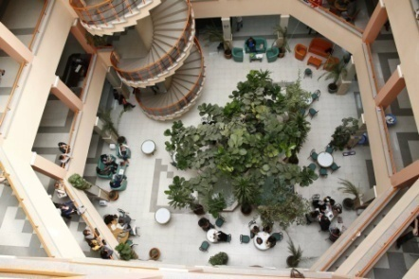
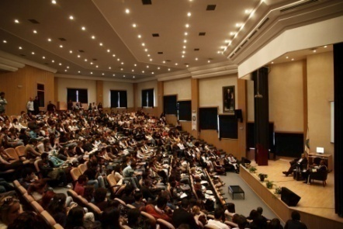
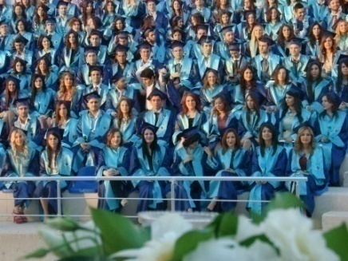
Faculty of Business Vision, Mission, Values and Motto
OUR VISION
To become one of the outstanding higher education institutions at the national and international level.
OUR MISSION
To contribute to discovery and development of individual and societal potential through its value adding education approach and research.
OUR CORE VALUES = TUSEC
Tolerance,
Unity,
Self-Confidence,
Entrepreneurship,
Creativity
OUR MOTTO
‘’ LEARN, THINK , PROGRESS’’

Slide 5
Departments
Department of Business Administration ( 1988)
Department of Economics (1992)
Department of International Relations (1992)
Department of Tourism Management (1994)
Department of International Business and Trade (2009)

Slide 6
Programs offered by the Faculty
 | Business Administration Deparment | Economics Department | International Relations Department | Tourism Management Department | International Business and Trade
Bachelor Degree | Business Administration | Economics | International Relations | Tourism Management | International Business and Trade
Master Degree | MBA Ms in Finance and Accounting Ms in Confilict Resolution Ms in Business Information System | Ms in Economics | Ms in International Realations | Ms in Tourism Management | Ms in Foreign Trade
PhD Degree | Ph.D in business adminstration | Ph.D in Economics | PhD in International Relations | PhD in Tourism Managemet
Double Degree with SUNY (Albany ) | Business Administration Bachelor | Economics Bachelor | International Relations Bachelor

Slide 7
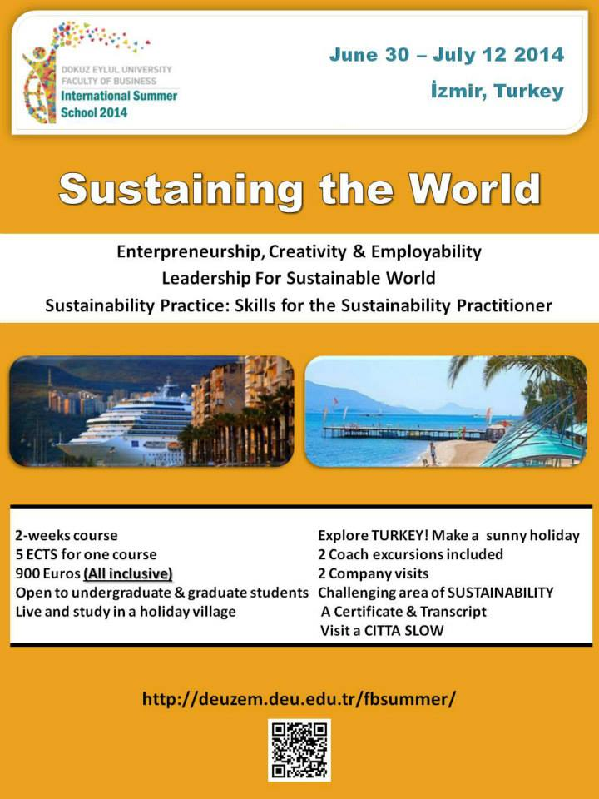
Faculty of Business at a glance
English -medium Instruction
Oppurtunity for Minor Degree
Interdisciplinary Course Options
Double Major
International Week
Double Degree
International Summer School

Slide 8
Faculty of Business at a glance
Curriculum updated in line with Bologna Principles and in use since 2011-2012 Academic Year
App. % 50 of the academic staff obtain their PhD. & master degree from leading universities in North America , Asia – Pasific or Europe
Several ongoing and completed research projects from FP7 , European Science Foundation and Scientific and Technological Research Council
Student Population is 1800 as of May 2017
Academic staff population is 100 including research assistants

Slide 9
Faculty Population
 | Academic Staff (100) | Student Population (1800)
Business Administration | 39 | 448
Economics | 17 | 384
International Relations | 22 | 270
Tourism Management | 14 | 224
International Bus. and Trade | 8 | 297

Slide 10
DEU Faculty of Business International Relations Office
(Since 1994 – First at the University)
Double Diploma since 1997
Erasmus since 2003
International Week Since 2008
Mevlana Program
International Summer School

Slide 11
International Agreements
22
COUNTRIES
Austria
Belgium
Bulgaria
China
Czech Republic
Spain
England
Finland
France
Germany
Hungary
Ireland
Italy
Romania
South Korea
Latvia
Lithuania
Poland
Slovenia
Crotia
The Netherlands
USA
11
ACADEMIC COLLABORATION AGREEMENTS
55
BILATERAL AGREEMENTS
3 DOUBLE DIPLOMA AGREEMENTS

Slide 12
International Student Placement Exam And Government Scholarship Agreements
SYRIA NIGERIA CHINA INDONESIA
TURKISH REPUBLICS
PAKISTAN MONGOLIA
IRAQ
MOROCCO
IRAN AFGANISTAN
SUDAN UKRANIE MOLDOVA KOSOVO
SOUTH KOREA

Slide 13
PROJECTS and NETWORKS
INTENSIVE PROGRAMS
Intercultural Communication
How to do Business in South-East Europe
Quantitative Research
FEE – Female Endaavour and Entrepreneurship
SMART –BIZZ
NETWORKS
Businet – comprises of 50 partner instutions that are located in Europe, America and Asia
Nice Network – comprises of 36 partner instutions that are located in Europe, North Africa and Asia

Slide 14
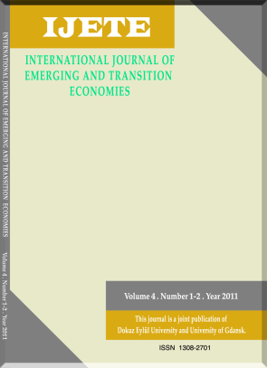
JOURNALS
Journal of Faculty of Business
DEU Faculty of Business & Gdansk University Institute of International Business
International Journal of Emerging and Transition Economies (IJETE) published by the Faculty twice a year

Slide 15
ECTS & DS LABEL
Dokuz Eylul University awarded with ECTS Label in December
Dokuz Eylul University awarded with DS Label in June 2012 by European Commission.

Slide 16
DEU Faculty of Business
Tınaztepe Yerleşkesi
Buca-İzmir 35390
Turkey
E-mail: iso@deu.edu.tr
Phone: +90 232 301 82 71
Fax: +90 232 453 50 62
Website : www.isletme.deu.edu.tr
Facebook: https://www.facebook.com/DEUBUSINESSFACULTY
Twitter: @DEU_BUS_FACULTY

