Slide 1


6-10 MAY 2024

Slide 2




Information about International Week (IW)
Opportunity for meeting with different instructors from different countries
Course promotions will be between 4-15 March 2024. Info meetings will be on 6,8,13 March at Z04 during lunch break
For IW annoucements please follow social media accounts, website and Sakai system!
Enrich your cultural, social, and personal growth.
Contribution to academic development
13 different instructors
CONTENT OF THE PRESENTATION:
instructions, rules, content of the courses& instructors of IW

Slide 3
IMPORTANT ISSUES
  Registration will be open between 11th to 15th of March 2024
  Done via Google Docs.
  You can choose only one course to register.
  Class Quota is limited with 25 students.
  Registrations will be done by first come first served basis.
  Participation, attendance are obligatory to earn 1 ECTS credit.
  Since IW is a Faculty activity, you will be excused from your class(-es) at the day and time when IW courses are given.

Slide 4

International Week (IW) Rules
  Attendance is obligatory !
  You will earn 1 ECTS credit if you attend & participate 3 full days.
  The credit you collect will be shown at your transcript
  Courses will be interactive
  IW courses will be held 7, 8, 9 of May 2024.

Slide 5

Participation and Attendance
Please think twice before registering the IW course!
Will you attend? Is the course interesting for you?
Will you really participate?
Since the class quotas are limited to 25 students if you do not attend the course than you prevent a friend from taking the course!!!

Slide 6


Adriaan van hoorn
Rotterdam University of Applied Sciences - The Netherlands
Cross Cultural Negotiation in International Business
Course Objective:
Students will learn how to negotiate in International Business settings, taking into account various cultural differences that occur in dealing with International companies and how to handle those differences appropriately
Learning Outcomes:
At the end of this course the learner is expected to:
Understand various Negotiation strategies and tactics ( Lewicky and Harvars Method) Know more about themselves as a person and how their preferred ( unconscious) style can be adapted if necessary in Negotiations situations Understand and modify their personal negotiation strategy and tactics if the situation requires this to achieve a good outcome
2nd, 3rd, 4th year students

Slide 7
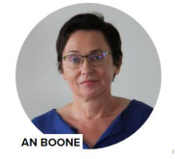
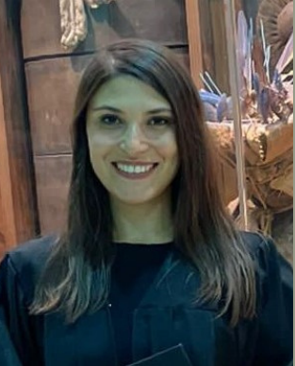
An Boone & Hümeyra Özdemir
Artevelde University College - Belgium
The Social Entrepreneurship Bootcamp
Course Objective:
In today's dynamic and rapidly changing world, mastering intrapreneurship and entrepreneurship is indispensable. Whether you see yourself as a proactive employee or an innovative employer, cultivating these skills is indispensable. In the social entrepreneurship bootcamp, we focus on refining your entrepreneurial skills.
Learning Outcomes:
At the end of this course the learner is expected to:
1. Gain knowledge on entrepreneurial potential as an individual, with a focus on social impact.
2. Gain knowledge on discovering opportunities, emphasizing social innovation.
3. Gain knowledge on business models, corporating social value.
4. Gain knowledge on financial resources with a focus on social impact
5. Gain knowledge on opportunities / ideas screening, with a social lens.
6. Gain knowledge on basic entrepreneurial issues, including social responsibility.
Develop critical thinking skills on developing a career as entrepreneurs, with a focus on social innovation
2nd, 3rd year students

Slide 8

Anna Kuzior
University of Economics in Katowice - Poland
How to determine the amounts presented in the financial statements? Valuation methods and models based on IFRS
Course Objective:
The objective of the course is to present students main valuation models used for financial and non – financial assets and the influence of these models on information presented in financial reports. Course will be illustrated using examples/case studies prepared based on International Financial Reporting Standards
Learning Outcomes:
1.Understand the main rules of measurement of assets,
2.Understand the idea of cost models and fair value models,
3. Be able to discuss and critically evaluate cost models and fair value models,
4. Understand the influence of valuation models on information presented in financial statement,
Be able to give proper examples of application of particular valuation models
3rd, 4th and graduate year students

Slide 9

Birdane Seckin
Saxion Universities of Applied Sciences - The Netherlands
Organization and People (Management Control)
Course Objective:
As future managers, the students understand, explain, and analyze the management control system of a company and come up with recommendations for improvement.
In this course, you will explore essential aspects of managing and controlling organizations, with a focus on understanding and applying concepts related to organizational structure, culture, HR policies, risk analysis, ethical considerations, and planning & control tools. By the end of this course, you will be equipped with the knowledge and skills necessary to assess, analyze, and contribute to effective management control systems within an organization.
Learning Outcomes:
  prepare an analysis of the organizational structure and culture of the chosen company.
  apply HR policies and culture in the management control system of an organization.
  recognize and analyze different types of risks.
  recognize ethical issues in management control.
  explain and apply the planning & control tools.
2nd, 3rd year students

Slide 10

Franczak Iwona phD
University of Economics in Katowice - Poland
Accounting for Business
Course Objective:
1.Presentation of the basics of knowledge in the field of management accounting - indicating the role of management accounting as a system supporting managers in the management process. Showing the problems of product cost identification and the basic methods of management accounting, supporting managers in making decisions.
2.Developing skills in creating an information base for the needs of management accounting.
3.Developing social skills in the field of broad understanding of instruments supporting the effectiveness of business.
Learning Outcomes:
  She/He knows the principles of creating information used in the management of economic units and the terminology used to describe the functioning of business units.
  Understands the rules of settling and calculating the costs. She / He can indicate the consequences of the attributes of creating and developing information resulting from the cost accounting for business sector units for effective management
  He/she communicates the content of financial and control reports in English
  Can communicate information resulting from the management accounting system to stakeholders and discuss the consequences of taking alternative courses of action.
2nd, 3rd, 4th year students

Slide 11

Jan de Wilde
Saxion Universities of Applied Sciences - The Netherlands
Global Personal Development
Course Objective:
The main objective of this course (three courses) wil be to enlarge your Global awareness in a world which is more and more becomming an international field of interaction. By enlarging selfknowledge, improve your self-image, learning skills to communicate based on your personal preferences you should should experience a greater feeling of confidence.
Learning Outcomes:
  Have a greater awareness of global interacting skills
  Greater sens of self-confidence
  Insight in own personality
  More relaxing way of approaching new people
3rd, 4th and graduate year students

Slide 12
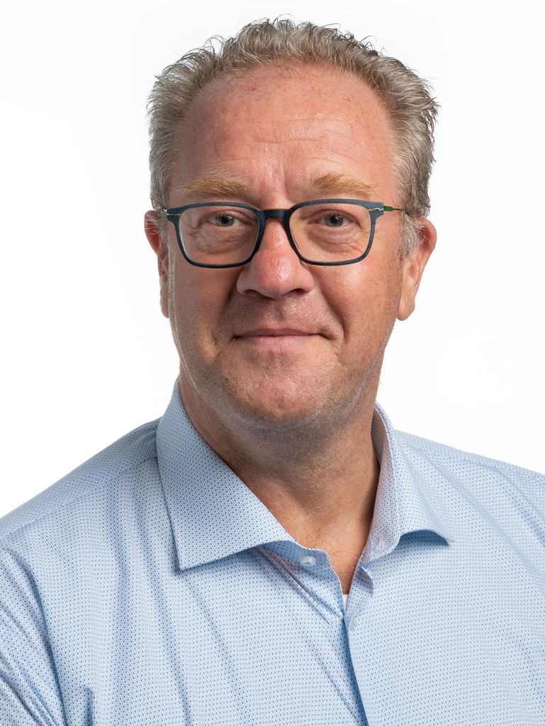
Jean-Pierre Beelen
University of Applied Sciences Rotterdam
Wholebeing for Intrapreneurs and Entrepreneurs
Course Objective:
The “total human principle” is a humanistic approach which examines the functioning of the human being on the basis of talent, orientation and character. What is the “Total Human Principle” and how can the total human principle contribute to your happiness and well-being?
In the chaotic world of business, we often forget to distinguish happiness in the working environment and happiness in your private life as an individual. How do we separate these two and how do we make sure to keep everything in balance? What is the ultimate goal in life? These are questions that are mostly asked by intra- and entrepreneurs due to a constant shifting in their working environment and often unbalanced work/private lifestyle.
The course is both theoretical, because you will learn all aspects of the SPIRE model, and practical by applying some methods and some techniques that contribute to your Whole Being.
Learning Outcomes:
  Understand the 5 elements of the SPIRE model,
  Apply some parts of the 5 elements concretely in your personal situation,
  Apply some parts of the 5 elements concretely in an organizational context
  SPIRE-check-in
2nd, 3rd, 4th and graduate year students

Slide 13
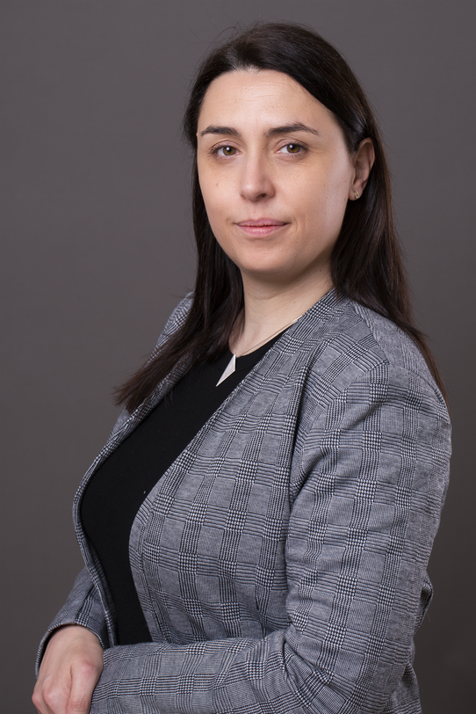
Karina Cicha, Ph.D.
University of Economics in Katowice - Poland
Gamify the issue! – gamification in social and business practices
Course Objective:
The aim of the course, conducted in a form of workshop, is to introduce students to methods of solving modern problems, business as well as social, through gamification. The course involves 5 stages of gamification development. They are as follows:
a) Defining the problem and assessing its solvability by means of gamification
b) Determining the group of target gamification participants and defining the desired behaviors of gamification participants
c) Building the participant's persona, determining the level of motivation
d) Implementation of a fun factor in the structure of gamification
e) Implementation of game mechanics, dynamics and components
Learning Outcomes:
1. The student gains knowledge allowing for the development of a gamified method of solving a business/ social problems based on communication with an external stakeholder.
2.The student knows the principles of planning, implementation (instruments and channels) and control, allowing the measurement of the effectiveness of the implemented project.
3.The student knows how to manage such processes and work with the project method within gamification.
4.The student independently plans and implements original and innovative project in the area of business or social issues, using innovative tools.
2nd, 3rd, 4th year students

Slide 14
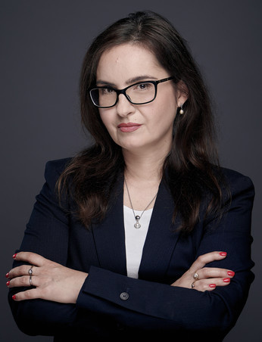
Krystyna Mitręga-Niestrój, Ph.D.
University of Economics in Katowice - Poland
GLOBAL FINANCIAL SYSTEM – FUNCTIONING, ROLE, AND DRIVERS OF CHANGE
Course Objective:
Recognize the main components and functions of the global financial system. Develop the ability to see the interdependencies in the global financial system and identify the problems of its relationship with the real sphere and society. Acquire the ability to identify and analyze the main drivers of change in the global financial system in the 21st century
Learning Outcomes:
1. Understand the functioning of the global financial system and its role in modern world.
2. Define and explain the fundamental components of the global financial system.
3. Understand the interdependence between global financial system and the real sphere of the economy.
4. Evaluate the role of international capital flows for the global financial system and economy.
5. Identify the key drivers of change in the global financial system, including economic, technological, and demographic factors
3rd, 4th and graduate year students

Slide 15

Niyazi Ozcelik
Windesheim University of Applied Sciences - The Netherlands
Positioning and branding across cultures
Marketing is not a war of products, it’s a war of perceptions
Course Objective:
Understanding cultural diversity, effective communication, cultural sensitivity, analyzing global markets.
Learning Outcomes:
1. Identify key cultural dimensions such as values, belief across different values
2.Analyze global markets to identify opportunities and challenges for branding and positioning strategies
3.Apply principles of effective communicate to tailor branding and positioning messages
4.Recognize the importance of cultural sensitivity in branding and positioning strategies to avoid misinterpretations and stereotypes
2nd, 3rd, 4th year students

Slide 16
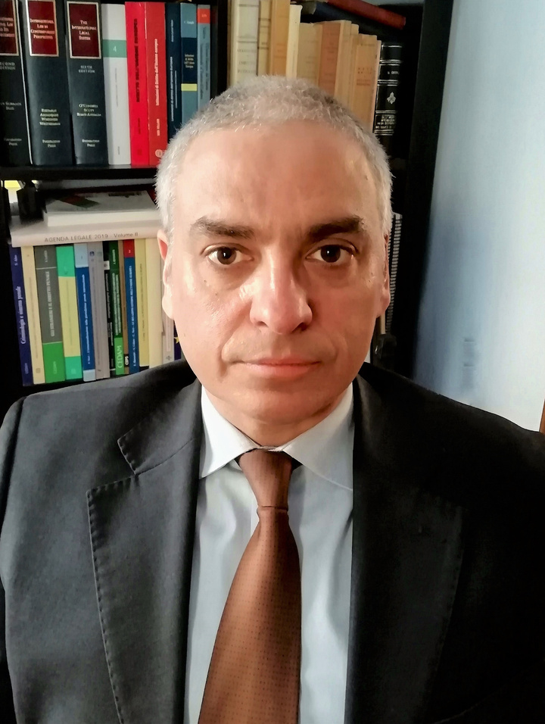
Prof. Dr. Paolo Bargiacchi
Kore University of Enna - Italy
Tackling international security threats through modern self-defence, international justice and spreading democracy and human security in the wider world
Course Objective:
International security and peace are hampered by new and evolving threats and challenges (terrorism, migration, atrocity crimes, cyber threats, etc.). States and the UN Security Council are revising and developing international law rules, solutions, and strategies to better tackle them. The course focuses on those areas and notions especially affected by modern threats and challenges whose legal frameworks are being evolving. A focus is also devoted to the EU strategy for spreading democracy worldwide and on the attempts to prosecute and punish international crimes committed in the context of the armed conflicts in Ukraine and Gaza.
Learning Outcomes:
1. Learn how international law is evolving to address contemporary security threats;
2. Understand the modern law of self-defense and assess its impact on the international rules on the use of force;
3. Compare drivers and push/pull factors for protecting both human rights and State security.
4. Assess the impact of the R2P doctrine and EU global strategy for democracy on international law and international relations;
5. Understand how international criminal law and judicial cooperation are developing to better tackle atrocity crimes and their perpetrators and which role can be played by international tribunals.
2nd, 3rd, 4th year students

Slide 17

Paulina Rutecka, Ph.D.
University of Economics in Katowice - Poland
Solve the problem with no code - no code application design
Course Objective:
The objective of the course is to familiarize students with the basic principles of creating logic of mobile and web application for business and the possibilities of their implementation in a no-code environment.
Classes include design work in the following areas in order to prepare mobile or web application as a solution for previously defined business problem:
a) Defining the problem and assessing its solvability by means of web or mobile app
b) Database and architecture design
c) Application logic based on the flowchart usage
d) Application content description supporting the user’s goals
e) App flow – basic application wireframes according to the defined UX
f) MVP – designing the application using the no-code platform
Learning Outcomes:
1. The student knows and understands the basic principles of creating and developing IT projects in the area of mobile and web applications using no-code platforms.
2. The student is ready to fulfill social obligations and to cooperate with the business environment using management concepts and IT techniques.
2nd, 3rd, 4th year students

Slide 18
IW Course Hours (7th, 8th, 9th May)
  07 May 2024,Tuesday 13.00- 16.00
  08 May 2024, Wednesday 09.30- 12.15
  09 May 2024, Thursday 10.00- 12.45

Slide 19
Thank you.
QUESTIONS?
isinsu.atalay@deu.edu.tr

