Slide 1
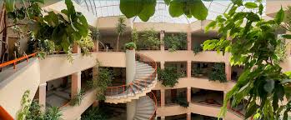

DOKUZ EYLUL UNIVERSITY
FACULTY OF BUSINESS

Slide 2

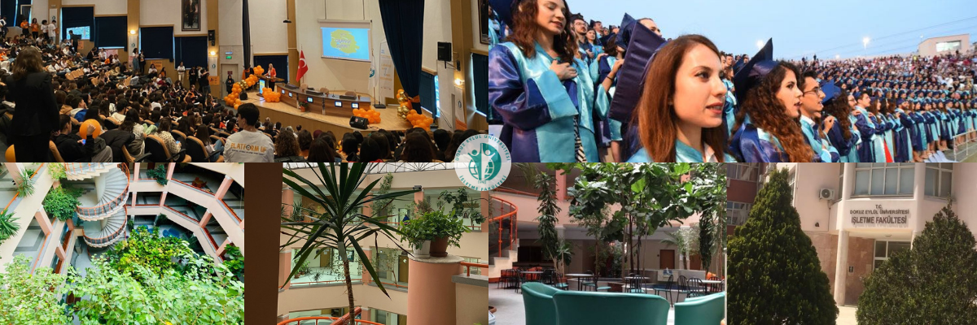
“LEARN, THINK, PROGRESS”

Slide 3
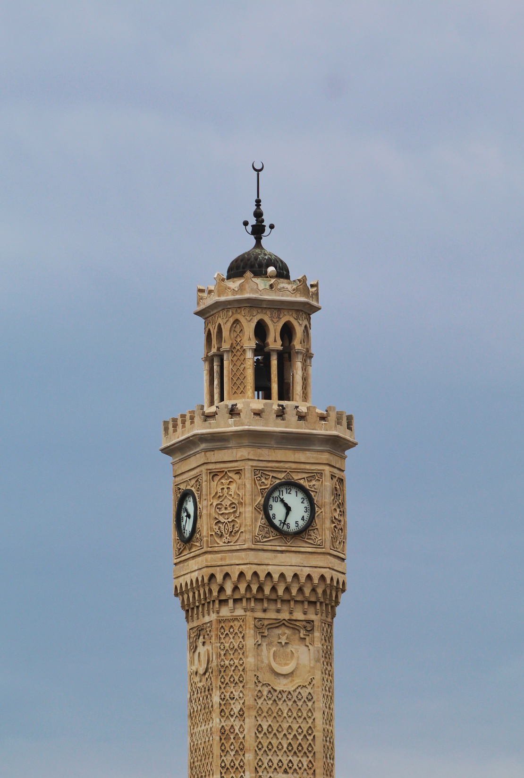
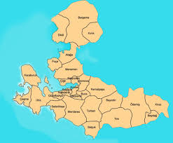
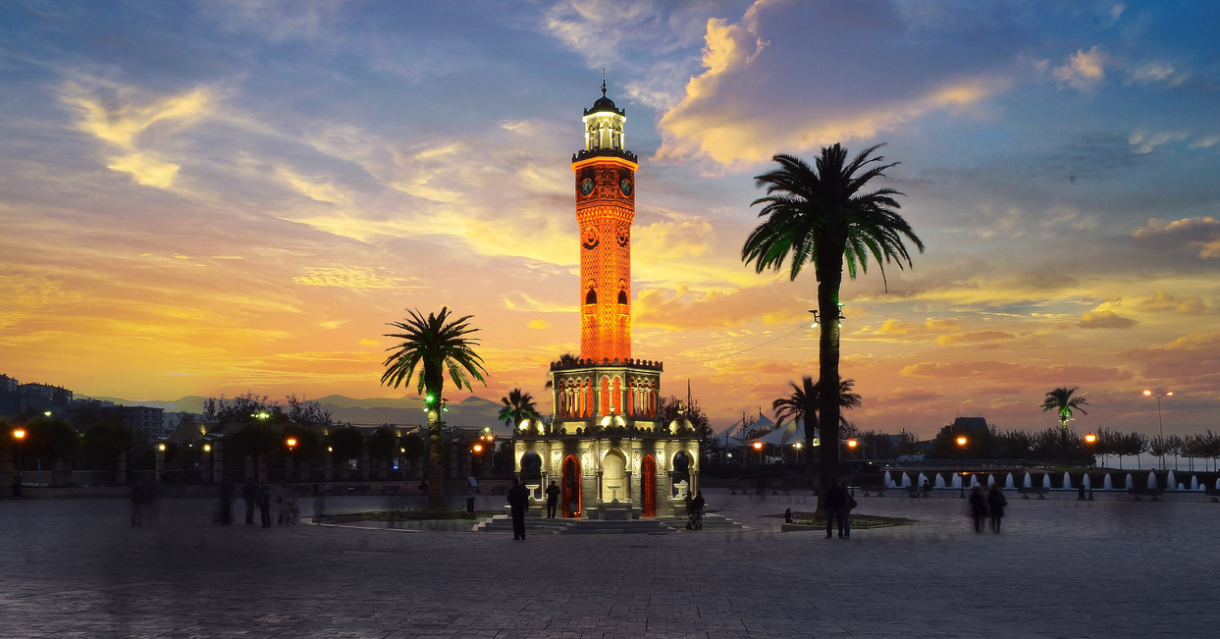
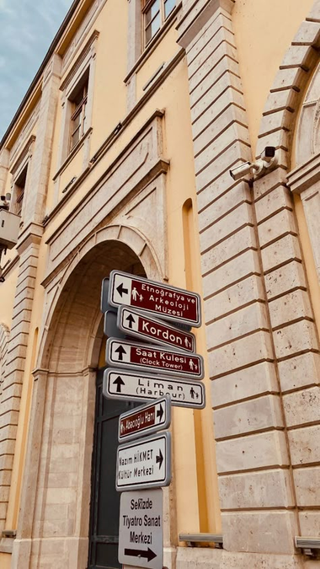
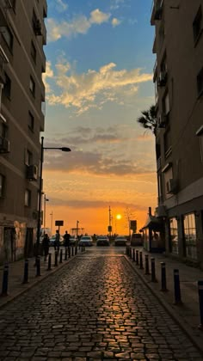
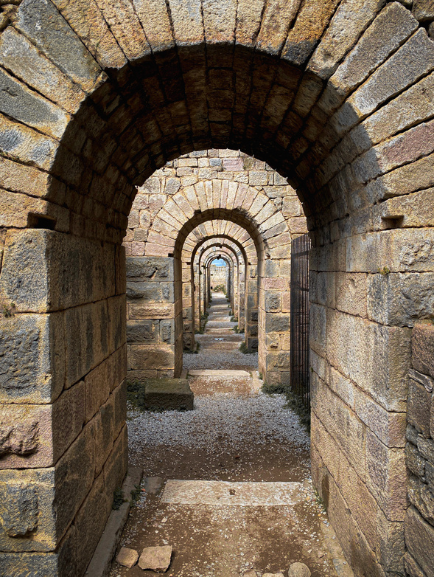
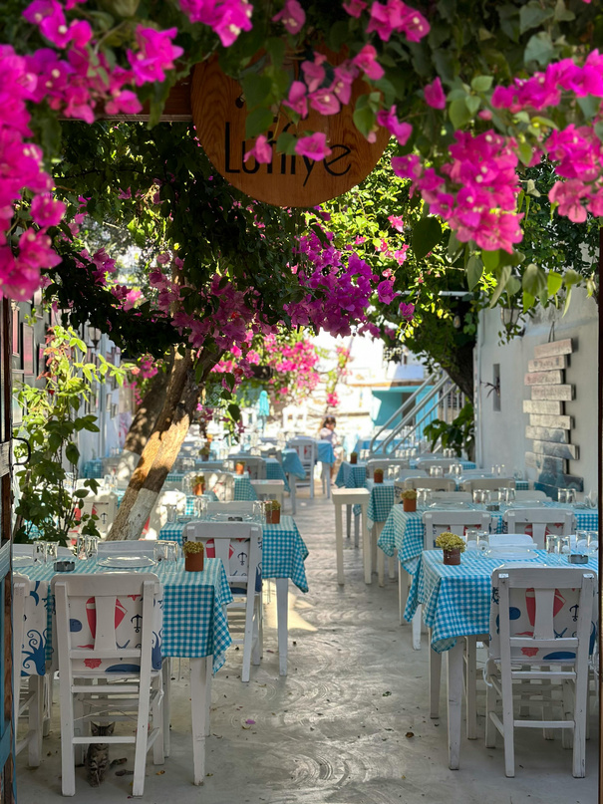


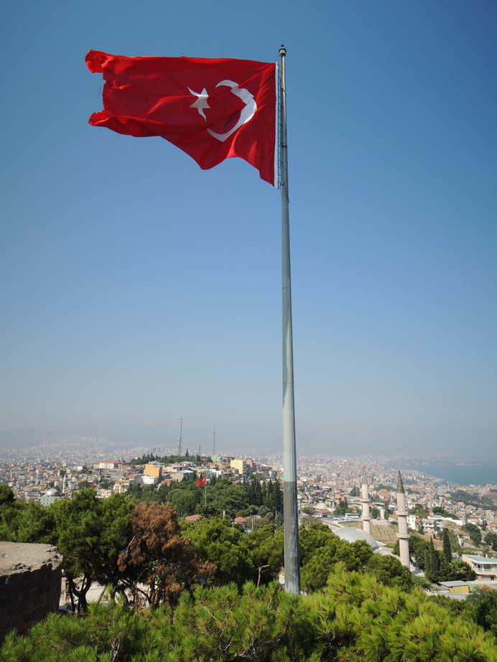
IZMIR
  A historic trade hub that has connected civilizations for millennia
  A multicultural city with a rich and diverse lifestyle
  One of the oldest cities in the world, with a history spanning 8,500 years
  Known as the "Cradle of Civilizations", home to ancient cultures and historical treasures
  A center for education and innovation, hosting 9 universities (both public and private)
  Surrounded by world-famous ancient cities like Ephesus, Pergamon, Teos, and Urla, offering a journey through history
  Close to stunning Aegean coastal destinations, including Çeşme, Gümüldür, Kuşadası, and Urla, perfect for summer getaways
  Enjoys a Mediterranean climate, with mild winters and warm, sunny summers

Slide 4


DEU AT GLANCE
•University was founded in 1982
• It is a city university with 13 campuses
• Presently has 18 Faculties, 6 Graduate Schools, 6 Vocational Schools , 4 Institutes , 62 Research Centers and Technopark
• Student population is around 75000
• Academic and Administrative Staff population is around 7000
• Accredited University (Offers Blue Print for all graduates)
• One of the pilot universities in internationalization
• As of November 2024, the name of its University Campus; “Tınaztepe Campus” has been changed to “Dokuz Eylül University Central Campus”

Slide 5


FACULTY OF BUSINESS
OUR VISION
To become one of the outstanding higher education institutions at the national and international level.
OUR MISSION
To educate entrepreneurs and leaders who have an international perspective, can keep pace with contemporary needs, and have learned lifelong learning; conduct activities that support sustainable development goals, and quality research.
OUR CORE VALUES (TUSEC)
Tolerance, Unity, Self-Confidence, Entrepreneurship, Creativity
OUR MOTTO
“LEARN, THINK, PROGRESS”

Slide 6
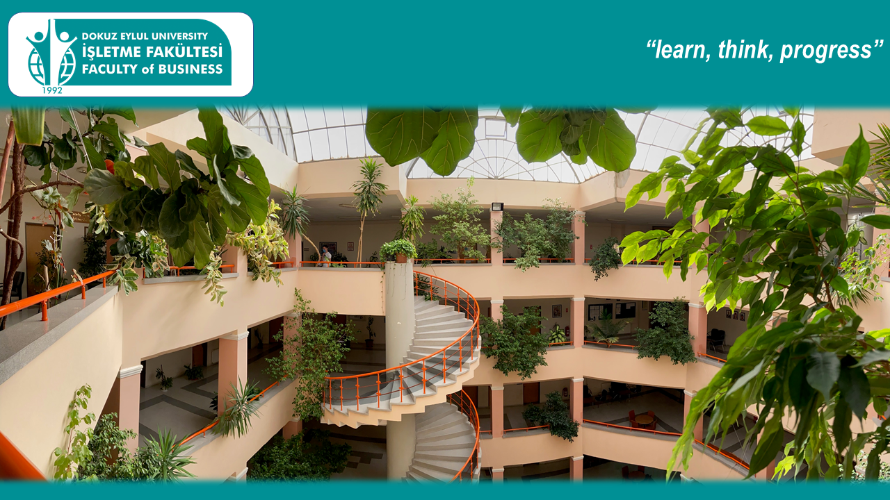

DEPARTMENS
Department of Business Administration (1988)
Department of Economics (1992)
Department of International Relations (1992)
Department of Tourism Management (1994)
Department of International Trade and Business (2009)
Firsts of Faculty of Business
English medium instruction (1988)
Foreign Language Education at the University (1989)
Student Club (BAClub) (1989)
Double Degree Program (1992)
Career Days (1992 )
Faculty International Office (1992)
Gender Equality Course in the curriculum (2016)

Slide 7
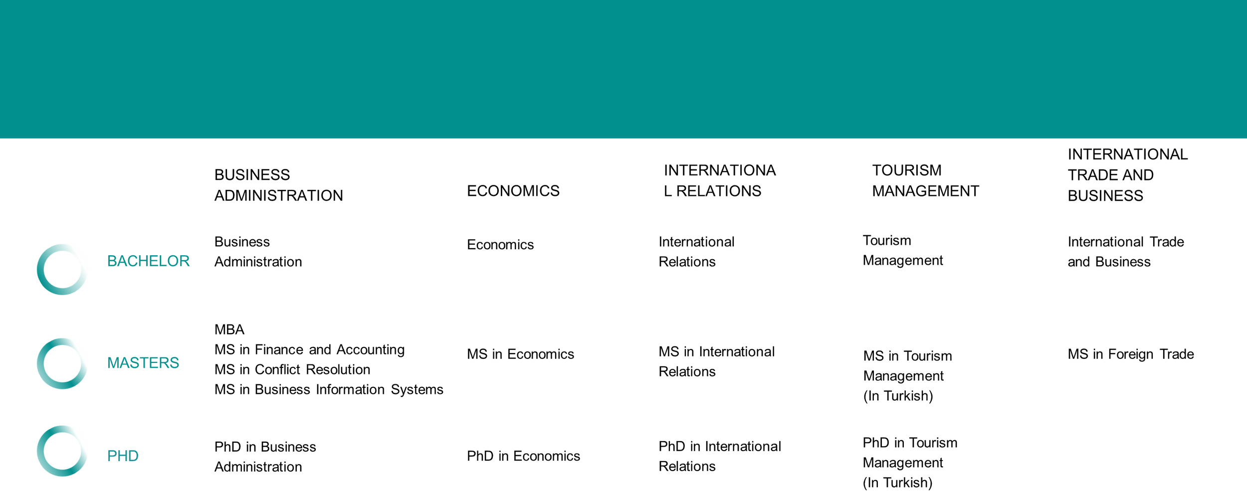
PROGRAMS

Slide 8
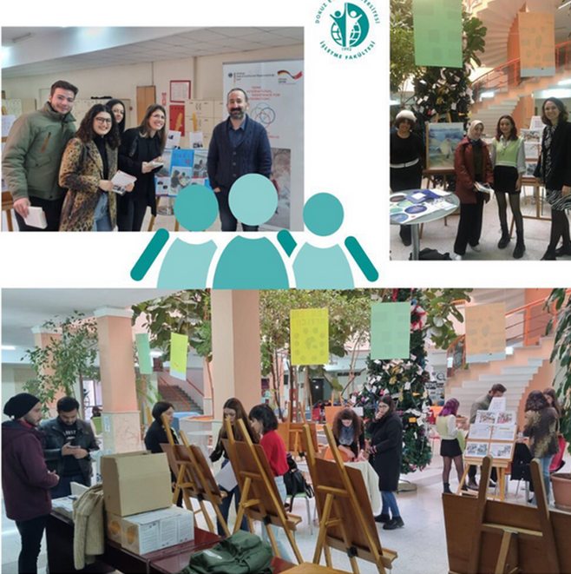
Faculty of Business at Glance
•App. 20% of the academic staff obtained their Phd. & master degrees from leading universities in North America, Asia – Pasific or Europe
•More than 20 ongoing research projects from Horizon, COST, European Science Foundation, Erasmus+ and Scientific & Technological Research Council of Turkiye
•Student Population is app 2700 and 20% is international degree seeking students
•Academic Staff population is approx. 90 including research assistants

Slide 9




Faculty of Business at Glance
•AACSB accreditation in progress since 2018
•NIBS Accredited in 2023
•ACC and FIN coded courses accredited by ACCA
•Finance major is affiliated under CFA university affiliation program
•Minors / Concentration opportunities
•Interdisciplinary Course Options
•Double Majors
•Double Degrees with SUNY – Albany Campus since 2017 in Business, Economics and International Relations
•International Week since 2007
•Faculty based Alumni Office organizes "Welcome Home" , ‘’Career Meet Up’’ and ‘’IFNetworkingNightout’’
•Continuous relations with the business world
•Career Kitchen and Tourism Summit organized by student clubs
•Orange Week

Slide 10


AACSB
•Applied to be a member of AASCB in September 2018
•To be a full member completed "Eligibility Application" process in May 2019
•Awarded as ‘’ Business Education Alliance Member’’ in July 2019 and then mentor is appointed
•To be a Business Education Alliance Member enables Faculty of Business to start its accreditation process
•Faculty of Business targets to be accredited by AACSB in 2026

Slide 11



International Projects and Networks
PROJECTS & SHORT PROGRAMS
•GEW 2020- Virtual Global Entrepreneurship Week
•POWERS - Peace, War and the World in European Security Challenges
•DIGIMATES
•EQUA-BUSINESS
•VSL on Finance
•Online winter and summer schools
•Online COIL Modules
•Hybrid modules and courses such as blended intensive programs (BIPs)
NETWORKS
•NICE Network (since 2006)
•BUSINET (since 2015)
•NIBS (since 2021) – NIBS accredited in 2023

Slide 12

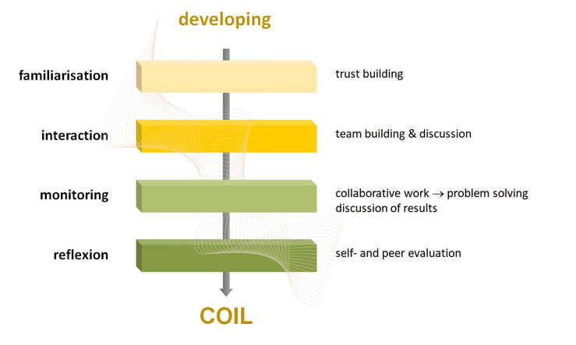
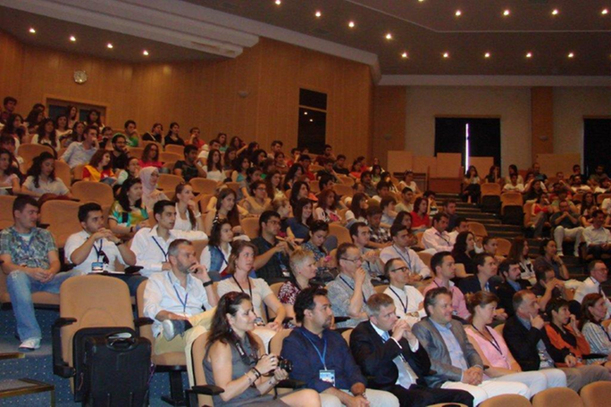
International Students and Scholars Office
ISSO
•1st International Office at the Faculty level since 1992
• Orientation, assistance, information and guidance for international students and scholars
•Runs all activities related to inbound / outbound student& staff exchange
•Organize International Week since 2007
•Manage and co- organize short term online programs & activities for students like COIL, BIP and Global Entrepreneurship Week
•Online International Week & summer/ winter school
Deals & follow the activities of the Faculty to improve the internationalization process of the Faculty

Slide 13
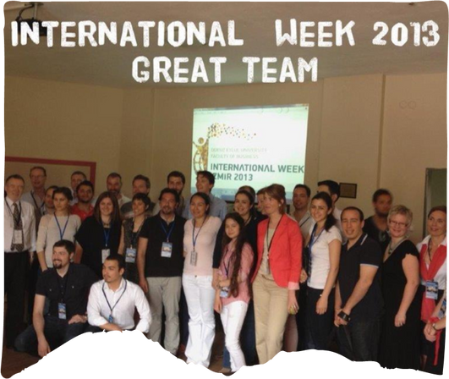
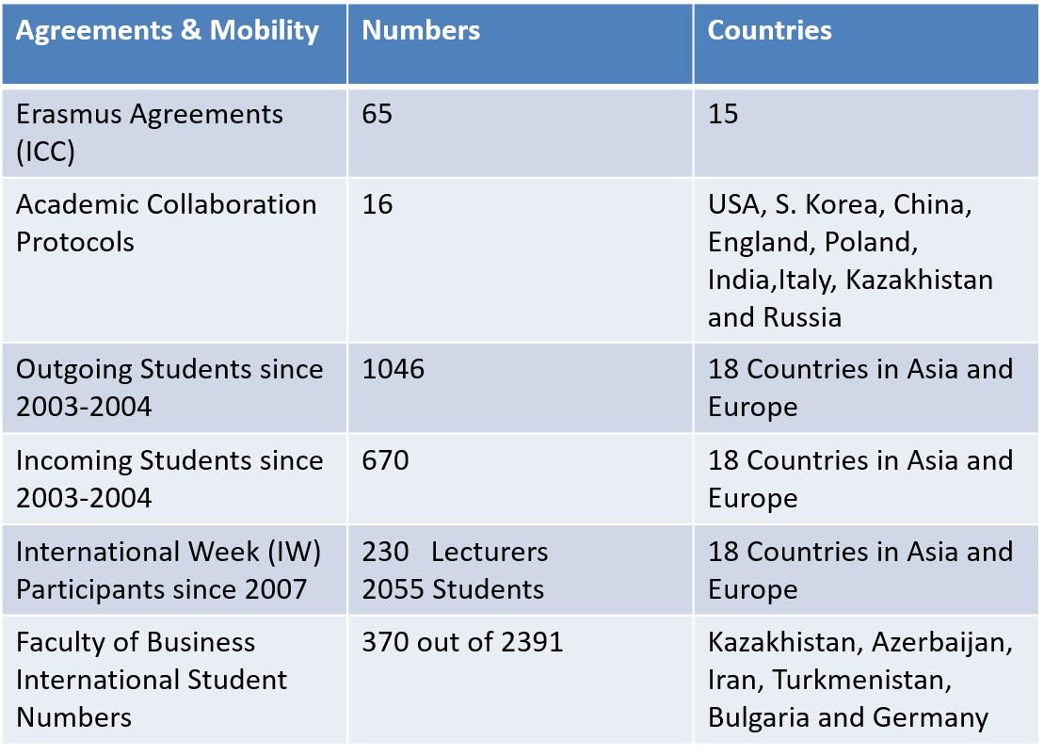
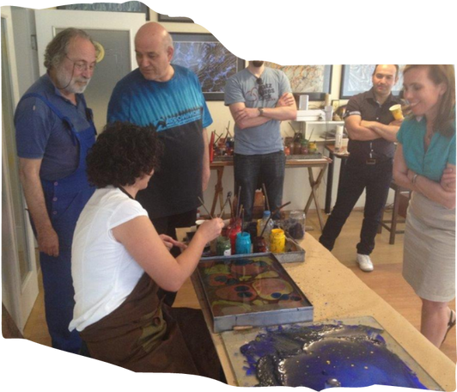
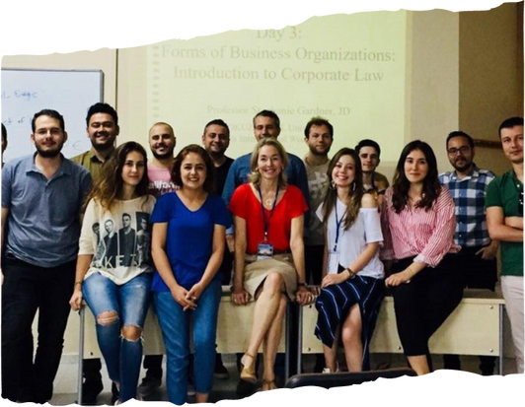
Some Facts & Figures About ISS0

Slide 14
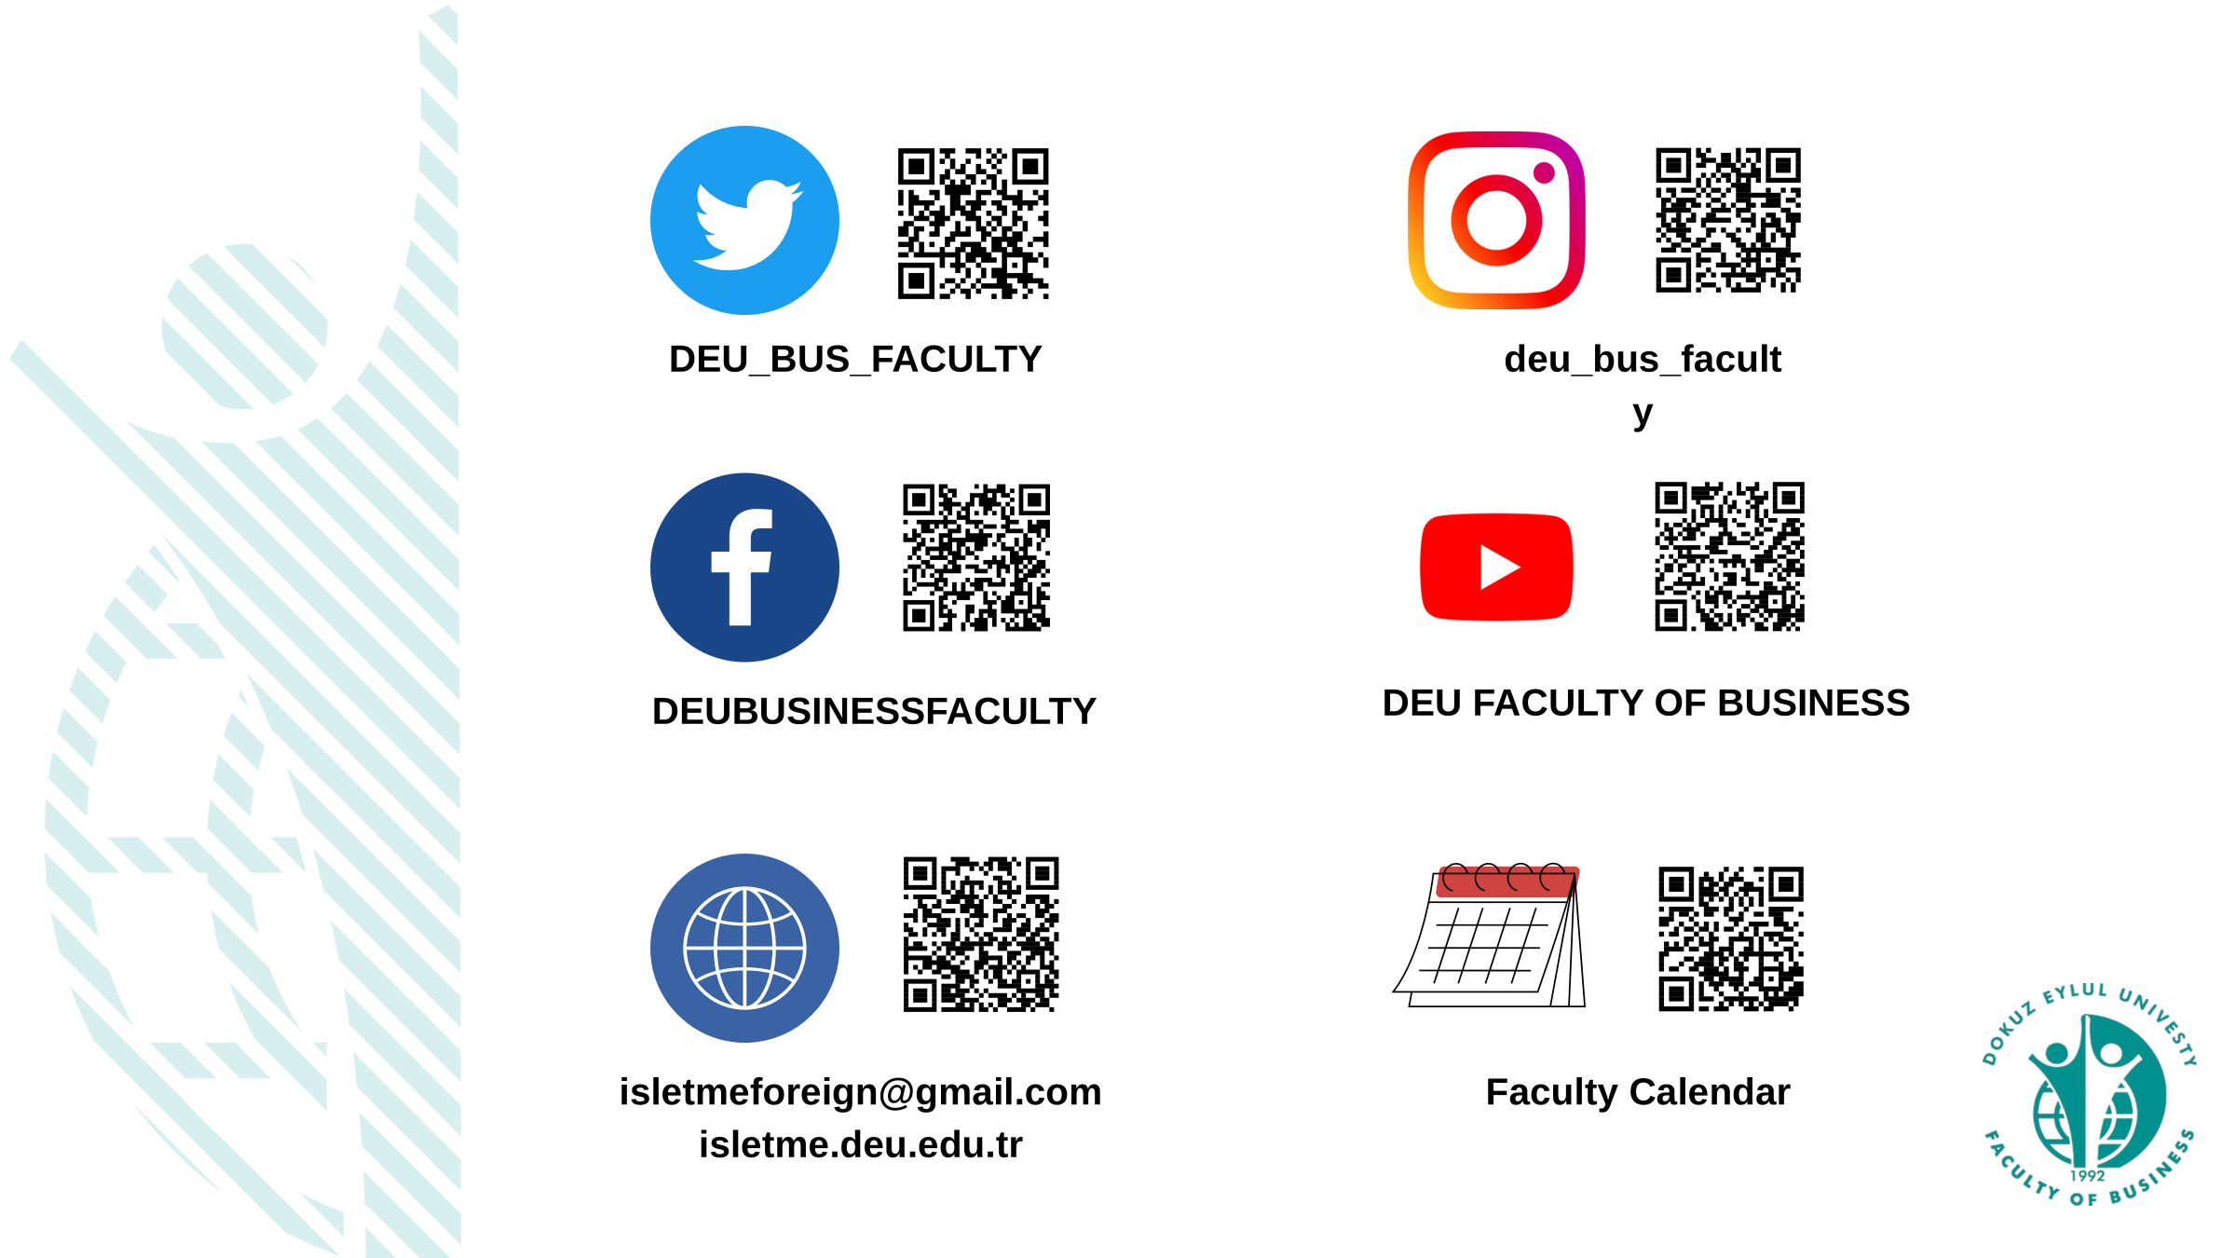

Slide 15
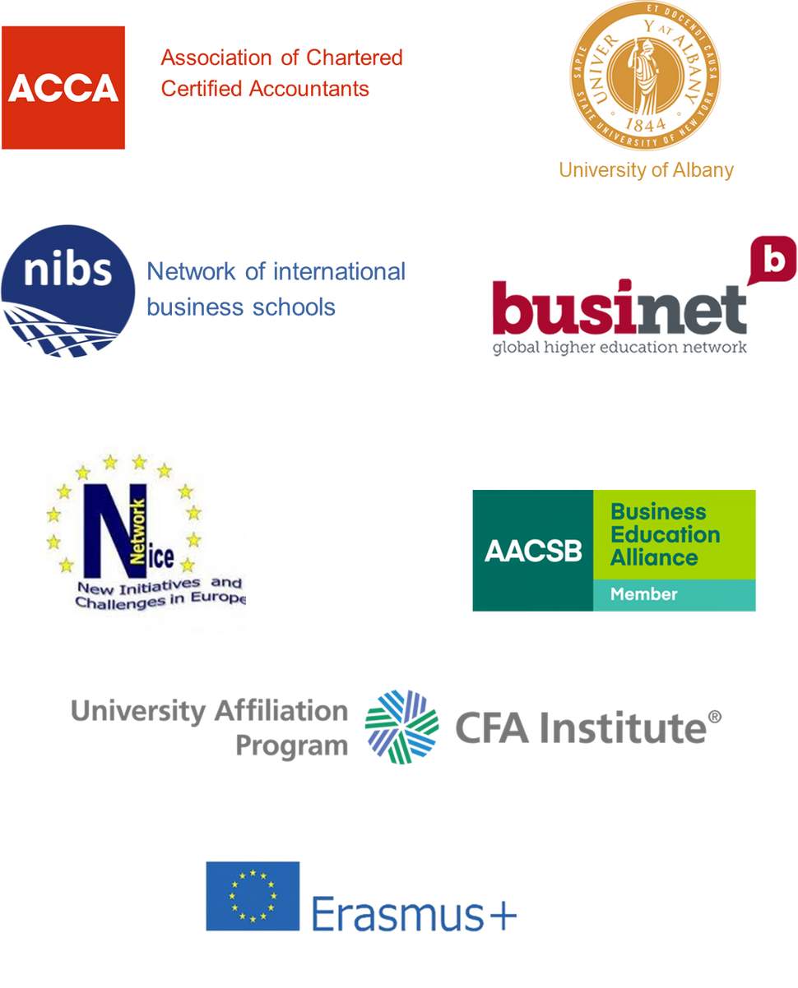

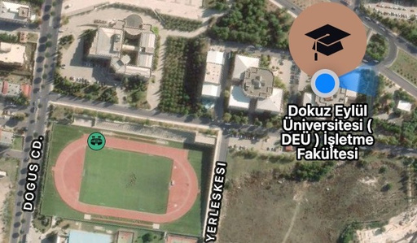
Address: İşletme Fakültesi,Tınaztepe Yerleşkesi 35390 - Buca / İZMİR
E-mail: isletmeforeign@gmail.com
Phone: +90 232 381 8172
Fax: +90 232 453 50 62

