Slide 1

11-13 May 2022

Slide 2
Opportunity for meeting different instructors from different countries...
6 different instructors
Registration to the courses will be online
on 23rd & 24th of March 2022
Please Follow Social Media Accounts and Website of the Faculty!
CONTENT OF THE PRESENTATION
instructions, content of the courses and instructors of International Week .

Slide 3

Important Issues
Registration
  23rd ,24th of March 2022
  You can select only one course
  Class Quata is up to 30 students
  First come first served based
Gain 1 ECTS credit
Participation and attendance is obligatory to collect 1 ECTS credit
Since IW is a Faculty activity , you will be permitted from the regular the courses .

Slide 4
International Week (IW) Rules
Registration : You have to register yourself via Google Docs 23rd and 24th of March 2022.
You can register yourself to only one course Attendance is obligatory !
You will collect 1 ECTS credit per course only if you attend and participate the course 3 full days.
IW courses will be held 11,12,13 of May 2022.
Since IW is a Faculty activity , you will be permitted from the courses you are taking at the Faculty.

Slide 5

Participation and Attendance
Students will be on the ‘’ Black List ‘’ for the future International Weeks, if they don not attend the course they already registered.
Being on the ‘’Black List’’ means you can not obtain any course ftom the future IW’s.

Slide 6
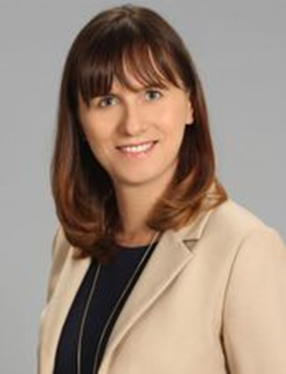
Prof.Dr. Anna Kuzior
University of Economics in Katowice, Poland
Big bath and cookie jar reserves: how companies can manage their earnings
(techniques of earnings based on IFRS)
Course Objective:
The objective of the course is to present possibilities of earnings management using assets and liabilities measurement rules accepted by International Financial Reporting Standards
Learning Outcomes
At the end of this course the learner is expected to :
Understand the purpose of financial statements,
Be able to discuss and critically asses methods of measurement of selected assets and liabilities,
Understand the idea and need of earnings management,
Understand the influence of assets and liabilities valuations rules on companies profit and loss,
Be able to take decision concerning a choice of accounting policy tools and techniques in particular situations
3rd, 4th year students & graduates

Slide 7
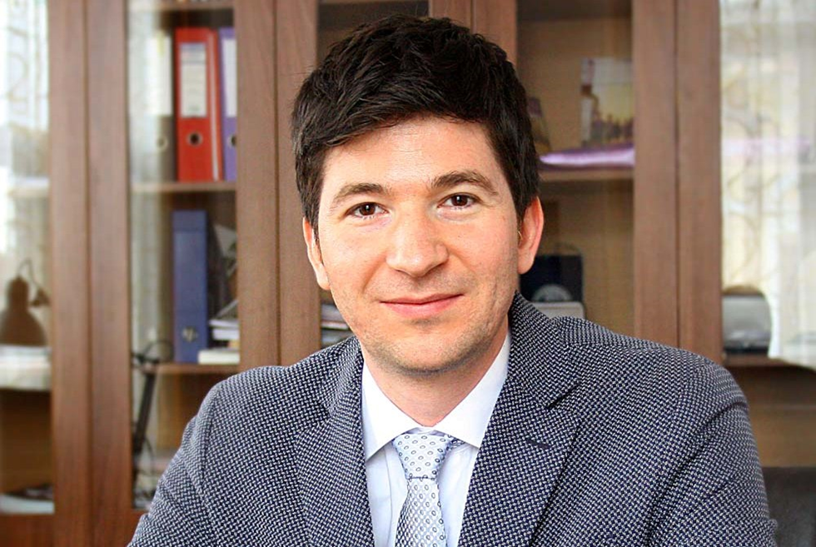
Prof.Dr. Ioan Alin Nistor
Babes Bolyai Uniersity, Faculty of Business, Romania
Behavioral Finance
  Course Objective:
Much of traditional economic and financial theory is based on the assumptions that
individuals act rationally and consider all available information in the decision-making
process and that markets are efficient. Behavioral finance challenges these assumptions and
explores how individuals and markets actually behave.
Learning Outcomes:
a. contrast traditional and behavioral finance perspectives on investor decision making;
b. contrast expected utility and prospect theories of investment decision making;
c. discuss the effect that cognitive limitations and bounded rationality may have on
investment decision making;
d. compare traditional and behavioral finance perspectives on portfolio construction and
the behavior of capital markets.
4th year and graduate students

Slide 8
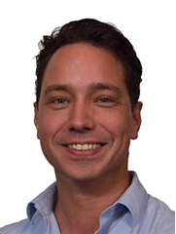
Lecturer Jan de Wilde
Saxion School of Commerce and Entrepreneurship ,Netherlands
Personal and Professional Growth
Course Objective:
Enlarge your self knowledge, feeling of confidence, self-image, communication preference and
people knowledge.
Learning Outcomes:
Have Improved his/hers self knowledge
Have Better skills on communication and presentations
Have a greater feeling of comfort when interacting with people
Be more aware of verbal and non-verbal (conscious and unconscious) communication
2nd,3rd and 4th year students

Slide 9
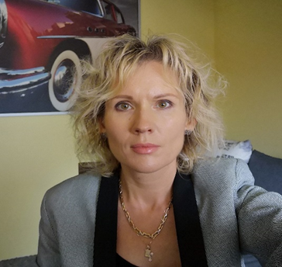
Dr. EWA TOKAJUK
Bialystok University of Technology Faculy of Engineering and Management ,Polland
How to manage Personal Finances?
Course Objective:
Understanding of financing and income sources
Ability to classify personal expenses
Learning Outcomes:
Learning how to create and implement a household budget
The student is to increase his financial awareness,
Understand the basic financial principles,
Learn financial planning.
2nd,3rd and 4th year students

Slide 10
Lecturer Ralf Kleijkers & Lecturer Lars Kortenschijl
Saxion School of Commerce and Entrepreneurship ,Netherlands
Managing Digital Transformation ( an overview)
Course Objective:
The course will be designed for students with a high interest in entrepreneurship
and management. The course will address the core elements of the Digital Transformation
Model. The main objective of the course is to make future digital leaders aware of the elements that enable and threat successful digital transformations.
Learning Outcomes:
Understand the critical components of digital transformation
Understand the technologies drivers of data driven organizations
Recognize and identify the key technologies and trends that drive data. Learners will be able to assess the impact of these technologies and trends.
Understand how to create business value triggered by improved data-driven decision making.
Understand the foundations of ethics, digital and automated decision making.
Understand and assess the risks related to applicable ethical principles (like transparency, responsibility, competence, trust and empathy) and guidelines.
https://www.linkedin.com/in/kleijkers/
https://www.linkedin.com/in/lars-kortenschijl-3031761aa/
3rd & 4th year and graduate students

Slide 11
IW Course Hours ( 11,12,13 May )
11th of May 2022, Wednesday
13.00-15.35
12th of May 2022 , Thursday
9.30 -12.15
13th of May 2022 , Friday
9.30 -12.15

Slide 12

Thanks for listening...
QUESTIONS???

