Slide 1

8-12 May 2023 Participants

Slide 2
Opportunity for meeting different instructors from different countries...
14 different instructors
Registration to the courses will be online
on 28th ,29,th,30th of March 2023
Please Follow Social Media Accounts ,Website and Sakai announcements!
CONTENT OF THE PRESENTATION
instructions, content of the courses and instructors of International Week .

Slide 3

Important Issues
Registration
  28th,29th,30th of March 2023
  Regisration will be via Google Docs on 28th, 29th, and 30th of March 2023.
  You can choose only one course to register
  Class Quota is 25 students
  First come first served basis
Participation, attendance, microphone and camera are obligatory to earn 1 ECTS credit
Since IW is a Faculty activity, you will be excused from your class(-es) at the day and time when IW courses are given .

Slide 4
International Week (IW) Rules
Attendance is obligatory !
You will obtain 1 ECTS credit if you attend & participate 3 full days.
The credit you obtain will be shown at your transcript
Courses will be interactive
IW courses will be held 9, 10, 11 of May 2023.

Slide 5

Participation and Attendance
Please think twice before registering the IW course!
Will you attend?
Is the course interesting for you?
Will you participate?
!!!Since the class quota are limited to 25 if you do not attend the course than you prevent a friend from taking the course!!!

Slide 6
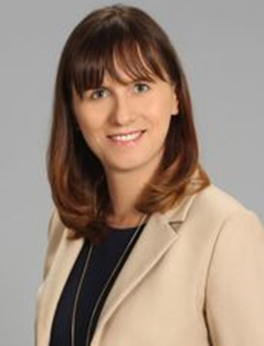
Prof.Dr. Anna Kuzior
University of Economics in Katowice, Poland
Why and how do companies practice accounting policy?
Course Objective:
The objective of the course is to present students tools of accounting policies using assets
measurement rules accepted by International Financial Reporting Standards
Learning Outcomes
At the end of this course the learner is expected to :
Understand the purpose and qualitative characteristic of financial statements
Understand the idea and tools of accounting policies,
Be able to discuss and critically asses methods of measurement of fixed and current assets,
Understand the influence of assets valuations rules on compan’s financial position,
Be able to take decision concerning a choice of accounting policies tools and techniques in particular situations
3rd, 4th year students & graduates

Slide 7
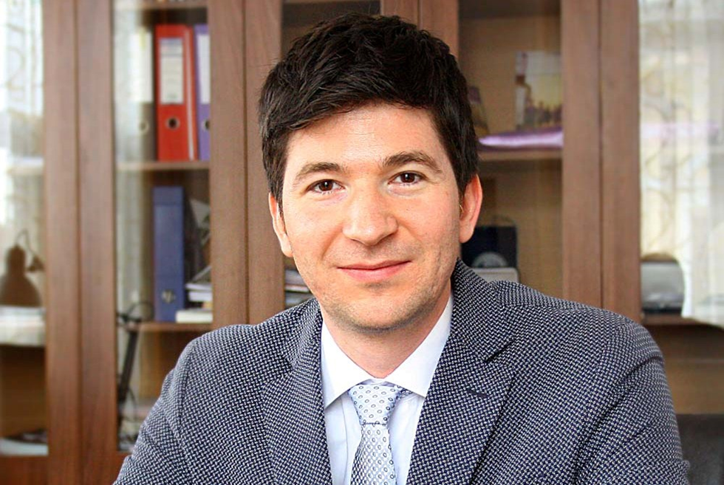
Prof.Dr. Ioan Alin Nistor
Babes Bolyai Uniersity, Faculty of Business, Romania
Behavioral Finance
  Course Objective:
Much of traditional economic and financial theory is based on the assumptions that
individuals act rationally and consider all available information in the decision-making
process and that markets are efficient. Behavioral finance challenges these assumptions and
explores how individuals and markets actually behave.
Learning Outcomes:
At the end of this course the learner is expected to :
a. contrast traditional and behavioral finance perspectives on investor decision making;
b. contrast expected utility and prospect theories of investment decision making;
c. discuss the effect that cognitive limitations and bounded rationality may have on
investment decision making;
d. compare traditional and behavioral finance perspectives on portfolio construction and
the behavior of capital markets.
3rd ,4th year and graduate students

Slide 8

Dr. Stephanie Gardner
Odisee University College, Belgium
Introducation to International Business Law
  Course Objective:
Students entering any field of business today must have a general knowledge of legal principles and
concepts in order to function effectively in our global environment. This three-day, interactive course
introduces the legal context in which business is conducted in common law and civil law jurisdictions.
Particular emphasis is placed on Contracts Law and Property Law. All sessions are aimed at helping
students to develop a “legal edge” in future business transactions.
Learning Outcomes:
At the end of this course the learner is expected to :
a basic understanding of the general legal framework, emerging trends and contemporary legal
debates related to business law, particularly in the global perspective; and increased ability to identify legal issues through enhanced interdisciplinary thinking, efficient communication and problem solving.
4th year and graduate students

Slide 9
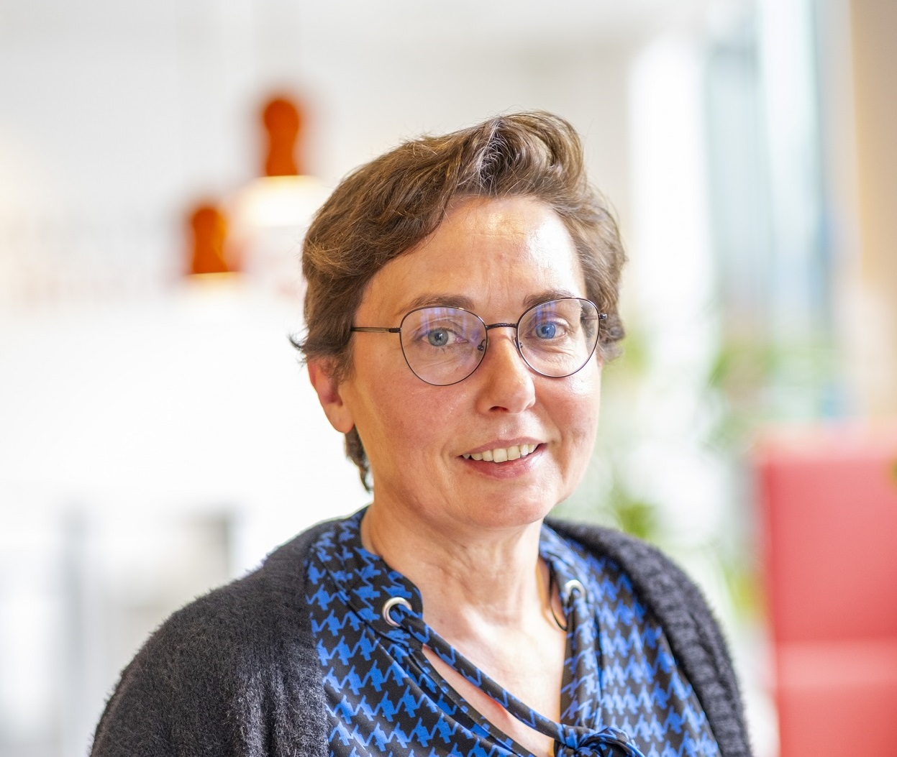
An Boone
Artevelde University of Applied Sciences , Belgium
Entrepreneurship Bootcamp
  Course Objective:
Intrapreneurship and entrepreneurship are crucial skills in this very rapidly changing world. Whether you will be working as an employee or an employer, these skills are an absolute must! During this entrepreneurial bootcamp, we will zoom in on your entrepreneurial skills and provide you with numerous techniques that will better prepare you for the VUCA (Volatility, Uncertainty, Complexity and Ambiguity) world.
Learning Outcomes:
At the end of this course the learner is expected to:
Gain knowledge on entrepreneurial potential as an individual.
Gain knowledge on discovering opportunities.
Gain knowledge on business models.
Gain knowledge on opportunities / ideas screening.
Gain knowledge on basic entrepreneurial issues.
Develop critical thinking skills on developing a career as entrepreneurs.
2nd and 3rd year students

Slide 10
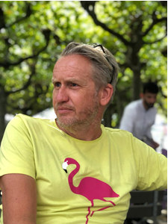

Lecturer Ralf Kleijkers & Lecturer Lars Kortenschijl
Saxion School of Commerce and Entrepreneurship ,Netherlands
Managing Digital Transformation ( an overview)
Course Objective:
The course will be designed for students with a high interest in entrepreneurship
and management. The course will address the core elements of the Digital Transformation
Model. The main objective of the course is to make future digital leaders aware of the elements that
enable and threat successful digital transformations.
Learning Outcomes:
At the end of this course the learner is expected to:
Understand the critical components of digital transformation
Understand the technologies drivers of data driven organizations
Recognize and identify the key technologies and trends that drive data. Learners will be able to assess the impact of these technologies and trends.
Understand the organisational impact and the organisational barriers.
Understand how to create business value with data and data-driven decision making.
Understand and assess the risks related to applicable ethical principles (like transparency, responsibility, competence, trust and empathy) and guidelines.
https://www.linkedin.com/in/kleijkers/
https://www.linkedin.com/in/lars-kortenschijl-3031761aa/
3rd & 4th year and graduate students

Slide 11
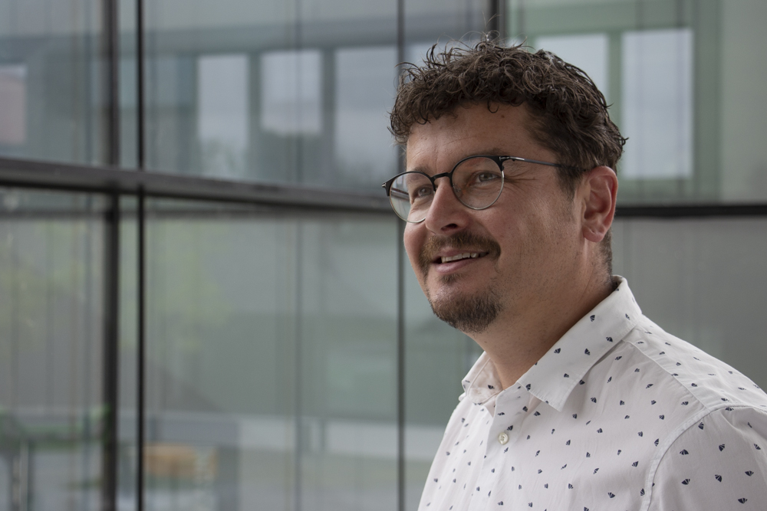
Prof. Dr. Thomas Meier
Technische Hochschule Deggendorf ,Germany
Controlling Practice: Analysis of “Big Data” and reporting with BI-Tools
Course Objective:
Controlling Practice: Analysis of “Big Data” and reporting with BI-Tools
Learning Outcomes:
At the end of this course the learner is expected to,
Know the functionality of a BI tool for data analysis
Be able to import and transform data from different data sources
Set up and design a management dashboard for reporting purposes in Microsoft Power BI
2nd, 3rd and 4th year students

Slide 12
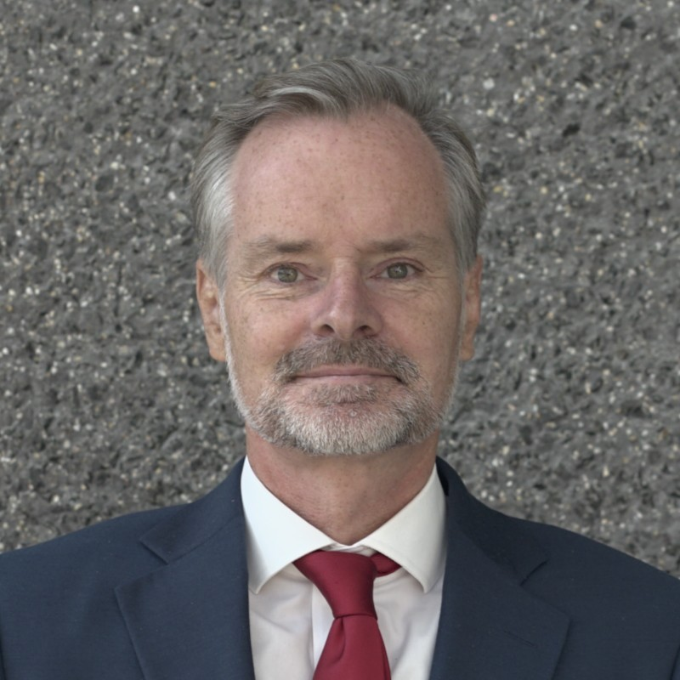
Prof. Dr. Tobias Nickel
Technische Hochschule Deggendorf ,Germany
Innovative Business Model Development:
Global Strategies for (G)Local Markets
Course Objective:
The students learn about the importance of business model innovations, that often have a bigger
impact than product or process innovations on a company’s success.
Learning Outcomes:
At the end of this course the learner is expected to:
understand and apply the business model navigator methodology
analyze existing business model
apply the similarity and contradiction method to generate new business models
be able to synchronize brand and business model
generate creative results in a team setting
3rd and 4th year students

Slide 13
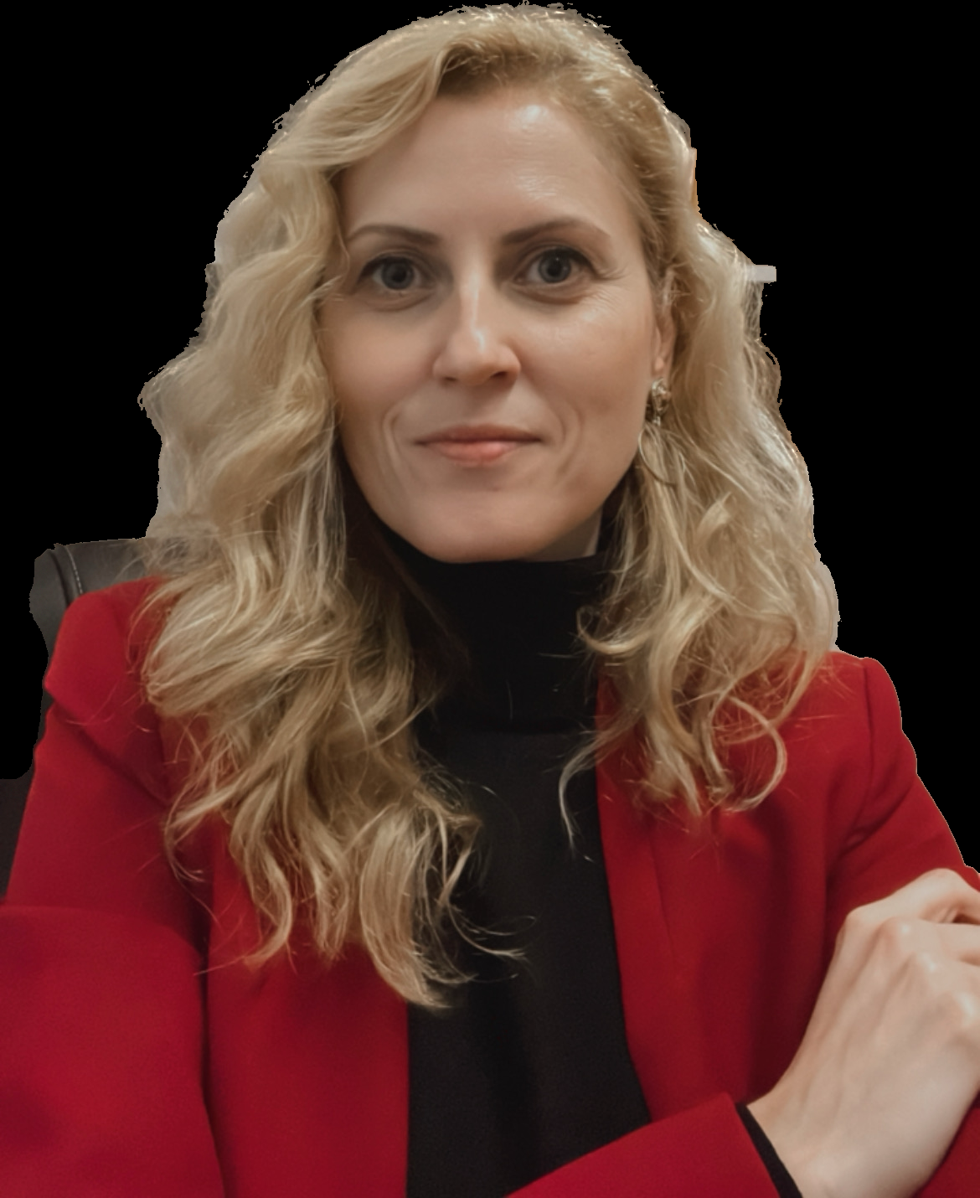
Lecturer Roxana Nistor
Babes Bolyai Uniersity, Faculty of European Studies , Romania
Intercultural Communication
  Course Objective:
  To understand the complexity and the dynamics of communication in situations of intercultural
  interactions and intercultural exchange.
Learning Outcomes:
At the end of this course the learner is expected to:
Master certain characteristics of interpersonal communication in different social contexts.
Understand the relation between culture and communication, the effects culture has on perceptions, behaviours, norms, and values.
Have the necessary “equipment” that allows for better communication in intercultural contexts.
Identify the obstacles that might harm an efficient intercultural communication.
2nd, 3rd ,4th year students

Slide 14

Dr. Zhonghui Ding
Ljubljana University, School of Economics & Business, Slovenia
Marketing in China
  Course Objective:
This course aims to provide students from a holistic point of view on Chinese culture and how does the culture impact consumers’ and businessmen’s mentality. In addition, as China is the leading country in e-commerce, this course also aims to introduce student the digital marketing strategies and marketing channels, business models with up-to-date examples.
  At the end of the course, students will also have change to learn basic business Chinese language.
Learning Outcomes:
At the end of this course the learner is expected to:
Understand the similarities and differences between Eastern and Western business mentality.
Get to know Chinese consumers’ characteristics across regions and city tiers.
Be familiar with the marketing strategies to approach Chinese consumers and Chinese market.
Be able to have a self-introduction in Chinese
3rd ,4th year and graduate students

Slide 15
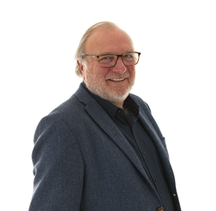
Adriaan van Hoorn
Rotterdam University of Applied Sciences, Netherlands
Cross Cultural Negotiation in International Business
  Course Objective:
  Students will learn how to negotiate in International Business settings, taking into account various cultural differences that occur in dealing with International companies and how to handle those differences appropriately
  Learning Outcomes:
At the end of this course the learner is expected to:
Understand various Negotiation strategies and tactics ( Lewicky and Harvards Method)
Know more about themselves as a person and how their preferred ( unconscious) style can be adapted if necessary in Negotiations situations
Understand and modify their personal negotiation strategy and tactics if the situation requires this to achieve a good outcome
2nd, 3rd ,4th year students

Slide 16
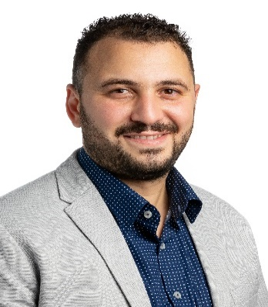
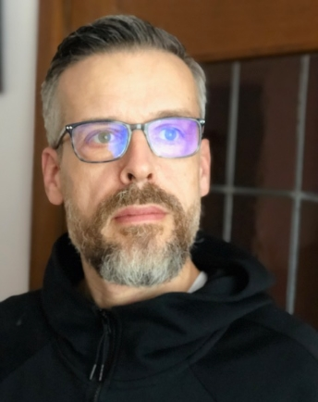
Hassan Alaoui & Alexander von Schmid
Rotterdam University of Applied Sciences, Netherlands
The reconstruction of Cambridge Analytica & Facebook Scandal using the case based
Teaching method
Introduction to data science using the case based teaching method
  Course Objective:
Reconstruct how Cambridge Analytica used the data of personality quizzes in conjunction with Facebook data to create psychographic profiles of users and develop targeted political advertising.
Discuss the ethical behavior of the different actors in this case, e.g. Facebook, Cambridge Analytica and the Trump campaign team who used targeted political advertising to get Trump elected.
  Learning Outcomes:
At the end of this course the learner is expected to:
Understand what data means, and what is done with it, or can be done with it
Acquire knowledge on different disciplines including political science, psychology, ethics, democratic elections and data science.
Conduct targeted desk research on different themes;
Explore the ethical perspectives on a case
Formulate ethical dilemmas, if any, in a case
Take a standpoint on an ethical dilemma and give arguments for it.
Understand ethical theories and how to use them
3rd ,4th year students

Slide 17
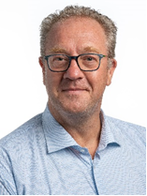
Lecturer Jean - Piere Beelen
Rotterdam University of Applied Sciences, Netherlands
Whole being for Intrapreneurs and Enterpreneurs
  Course Objective:
The “total human principle” is a humanistic approach which examines the functioning of the human being on the basis of talent, orientation and character. What is the “Total Human Principle” and how can the total human principle contribute to your happiness and well-being?
In the chaotic world of business, we often forget to distinguish happiness in the working environment and happiness in your private life as an individual. How do we separate these two and how do we make sure to keep everything in balance? What is the ultimate goal in life? These are questions that are mostly asked by intra- and entrepreneurs due to a constant shifting in their working environment and often unbalanced work/private lifestyle.
The course is both theoretical, because you will learn all aspects of the SPIRE model, and practical by applying some methods and some techniques that contribute to your Whole Being.
Things you already do well will be reinforced and things that don't work will be improved.
Whether you are already happy or want to become happier, this course will help, not only to make you happier, but the people around you as well.
Our life purpose is and should be the well-being of the “total human being"
  2nd, 3rd ,4th year and graduate students

Slide 18
Online IW Info Sessions Via Zoom
21 of March 2023, Tuesday
Time :13.00
Join Zoom Meeting
https://us02web.zoom.us/j/84444824127?pwd=YkpyOTY1dmFmam82OXRnU0hldHZzQT09
Meeting ID: 844 4482 4127
Passcode: IW2023
23rd of March 2023 , Thursday
Time: 15.00
Join Zoom Meeting
https://us02web.zoom.us/j/89576138332?pwd=RXJrcWNMcitlQXpJdGkzeHBOUmZ6dz09
Meeting ID: 895 7613 8332
Passcode: IW2023
28th of March 2023 , Tuesday
Time: 11.30
Join Zoom Meeting
https://us02web.zoom.us/j/84489908509?pwd=V01uSlRTWUhuT0dyU3NEN1NVM3pqZz09
Meeting ID: 844 8990 8509
Passcode: IW2023

Slide 19
IW Course Hours ( 9th, 10th, 11th May )
9th of May 2023, Tuesday
13.00-16.00
10th of May 2023 , Wednesday
9.30 -12.15
11th of May 2023 , Thursday
10.00 -12.45

Slide 20

Thank you...
QUESTIONS???
isinsu.atalay@deu.edu.tr

