Slide 1


12-16 MAY 2025

Slide 2




Information about International Week (IW)
Opportunity for meeting with different instructors from different countries
Course promotions will be between 3-14 March 2025. Info meetings will be on 6,12,13 March at A Block Z-07 (ED-Z-3) during lunch breaks.
For IW annoucements please follow social media accounts, website and Sakai system!
Enrich your cultural, social, and personal growth.
Contribution to academic development
8 different instructors
CONTENT OF THE PRESENTATION:
instructions, rules, content of the courses& instructors of IW

Slide 3
IMPORTANT ISSUES
  Registration will be between 18th to 20th of March 2025.
  Done via Google Forms.
  You can choose only one course to register.
  Class Quota is limited with 25 students.
  Registrations will be done by first come first served basis on 18th to 20th of March.
  Participation, attendance are obligatory to earn 1 ECTS credit.
  Since IW is a Faculty activity, you will be excused from your class(-es) at the day and time when IW courses are given.

Slide 4

International Week (IW) Rules
  Attendance is obligatory !
  You will earn 1 ECTS credit if you attend & participate 3 full days.
  The credit you collect will be shown at your transcript
  Courses will be interactive
  IW courses will be held 13, 14, 15 of May 2025.

Slide 5

Participation and Attendance
Please think twice before registering the IW course!
Will you attend? Is the course interesting for you?
Will you really participate?
Since the class quotas are limited to 25 students if you do not attend the course than you prevent a friend from taking the course!!!

Slide 6

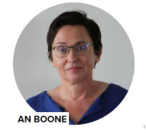
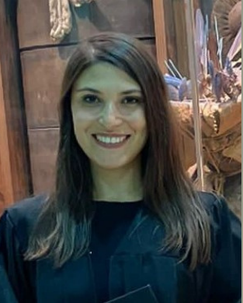
An Boone & Hümeyra Özdemir
Artevelde University College - Belgium
Future Forward: Social Innovation Bootcamp
Course Objective:
In today's fast-evolving world, the ability to think and act like an entrepreneur—whether within an organization or as a founder—is more critical than ever. Rapid digitalization, sustainability challenges, and shifting global markets demand agile and impact-driven professionals. In this social entrepreneurship bootcamp, you will develop essential intrapreneurial and entrepreneurial skills to navigate these changes, drive innovation, and create meaningful solutions for the future.
Learning Outcomes:
At the end of this course the learner is expected to,
1. Assess their entrepreneurial potential with a focus on social impact and sustainable innovation.
2. Identify and seize opportunities in the circular economy, inclusivity, and digital transformation.
3. Develop sustainable business models that balance social value and financial viability.
4. Explore innovative funding options, including impact investing and crowdfunding.
5. Apply strategic thinking in opportunity screening, considering societal needs and market trends.
6. Implement core principles of entrepreneurship, ethics, and stakeholder management.
7. Cultivate a future-oriented mindset for careers in social entrepreneurship or intrapreneurship.
2nd , 3rd, 4th year students

Slide 7

Ana Gabriela Pantea
Babes-Bolyai University - Romania
Security And Cooperation In Asia
Course Objective:
East Asian region, composed of China, Koreas and Japan, exhibiting diverse security challenges. As East Asia rises comprehensively in hard and soft power configurations recently, it also faces formidable security challenges in both traditional and non-traditional spheres. With the disintegration of the then Soviet Union, security aspects are being studied in traditional and non-traditional areas and these present rich research possibilities. As several traditional and non-traditional security challenges are cross-border, or even trans-continental, in nature and impact, this course introduces such themes with emphasis on the Chinese and East Asian perspectives. The core objectives of this course are: to provide an understanding and analysis on the thought and processes of traditional and non-traditional security aspects of China and East Asia, with emphasis on internal debates; to equip students with latest techniques in research on the subject and reflect on future possibilities.
Learning Outcomes:
At the end of this course the learner is expected to,
  Critical thinking
  Combining individual work with team work
  Using interdisciplinary frames for addressing the social aspects of international relations
3rd, 4th year students

Slide 8
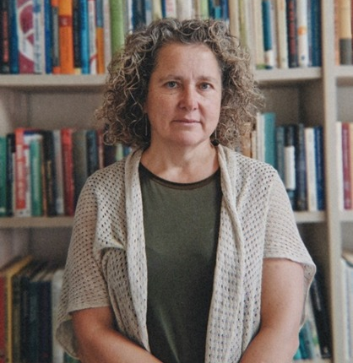
Ana Vinuela, Ph.D.
University of Oviedo – Spain
“Imagine that tomorrow you start working for an Export-Import company…. And now what?”
Course Objective:
The course "Imagine that tomorrow you start working for an Export-Import company... And now what?" immerses students in a real-world scenario: working for an Export-Import company in İzmir, Türkiye. Students will navigate key challenges of international trade, from their first transactions to understanding complexities beyond national trade—negotiation, cultural differences, currencies, and regulations. The course also covers global trade frameworks, including the WTO, 2020 Incoterms, payment methods, the Vienna Agreement, and the role of International Chambers of Commerce.
Learning Outcomes:
At the end of this course the learner is expected to,
1.⁠ ⁠Understand the WTO exceptions to the non-discriminatory principle
2.⁠ ⁠Being aware of the main differences in international negotiations and contracts (in comparison to domestic ones)
3.⁠ ⁠Understand the importance of the Incoterms
4.⁠ ⁠Being able to make an export offer (depending on the conditions agreed)
5.⁠ ⁠Electing a selection criteria to choose among different import offers
6.⁠ ⁠Getting the clearance of the goods at the Customs
3rd , 4th year students

Slide 9

Anna Kuzior
University of Economics in Katowice - Poland
How to determine the amounts presented in the financial statements? Accounting concepts and accounting policies tools based on IFRS
Course Objective:
The objective of the course is to present students accounting concepts/conventions/assumptions and tools of accounting policies using assets measurement rules accepted by International Financial Reporting Standards.
Learning Outcomes:
At the end of this course the learner is expected to,
1.⁠ ⁠Understand the purpose and qualitative characteristics of financial statements
2.⁠ ⁠Understand the main accounting concepts/conventions/ assumptions
3.⁠ ⁠Understand the idea and tools of accounting policies,
4.⁠ ⁠Be able to discuss and critically assess methods of measurement of fixed and current assets,
5.⁠ ⁠Understand the influence of assets valuation rules on a company’s financial position,
6.⁠ ⁠Be able to decide on a choice of accounting policies tools and techniques in particular situations
3rd , 4th year students

Slide 10
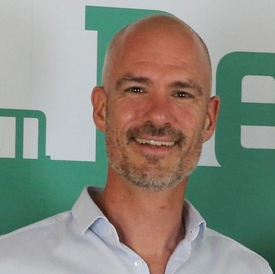
Hidde Bulten
Saxion Universities of Applied Sciences - The Netherlands
The Coffee Challenge, an accounting management game.
Course Objective:
Using a management game to let students experience that accounting can help them to make better business decisions and achieve company goals.
Learning Outcomes:
At the end of this course the learner is expected to,
1. Use basic accounting techniques to make better decisions. These techniques include CVP-analyze, NPV and payback period and Budgeting
2nd , 3rd year students

Slide 11
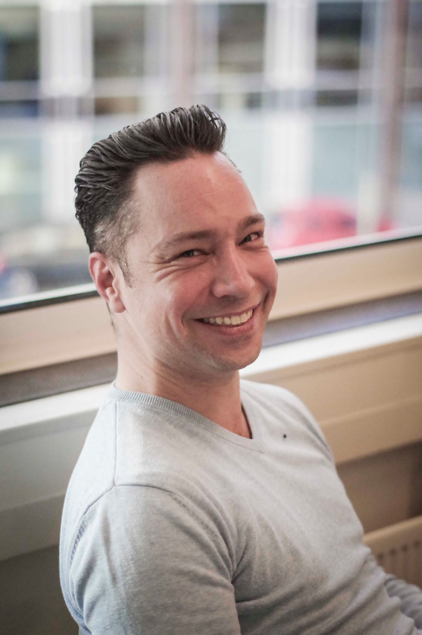
Jan de Wilde
Saxion Universities of Applied Sciences - The Netherlands
Communication is everywhere and universal
Course Objective:
The objective of these lessons to improve your global communication skills. To gain on self-awareness and feeling comfortable in an international context. Participants will experience more confidence in situations in which lots of people feel uncomfortable.
Learning Outcomes:
  At the end of this course the learner is expected to,
  1.⁠ ⁠Better equipped to communicate globally
  2.⁠ ⁠More self-confidence in communicating across borders
  3.⁠ ⁠Broadening horizons
  4.⁠ ⁠Less fear of failure in communication (self-awareness)
2nd , 3rd, 4th year students

Slide 12
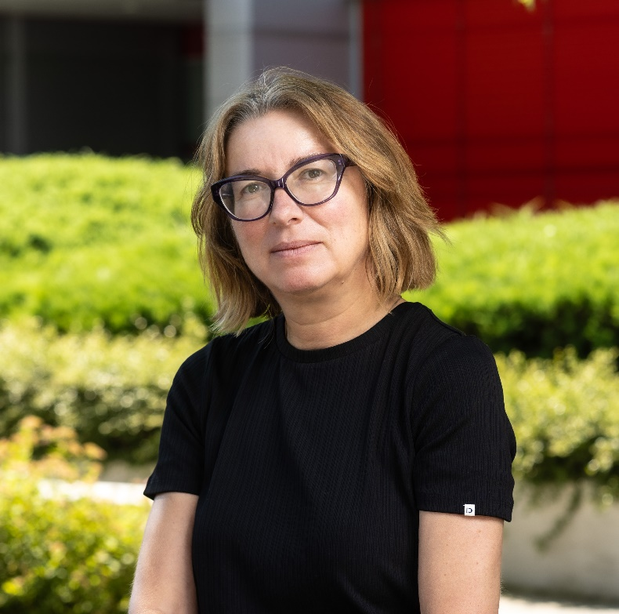
Melita Balas Rant
University Of Ljubljana – Slovenia
Building Leadership Capacity
Course Objective:
The course covers advanced topics of leadership, including authentic leadership, energetic leadership, and paradoxical leadership. These topics, together with essential leadership skills, will distinguish effective leaders from less effective ones in the age of AI, rising inequality, and increasing global uncertainty.
Learning Outcomes:
At the end of this course the learner is expected to,
1. Development of conceptual understanding of advanced leadership theories (knowing):
1.1. Authentic leadership in flow;
1.2. Energetic, ritualistic and charismatic leadership;
1.3.Paradoxical leadership though uplifted psychological states.
2. While practicing core leadership skills (doing);
3. And developing leadership attitudes (being);
4. Self-inquiry and reflexive analysis of others.
3rd and 4th year students

Slide 13
IW Course Hours (13th , 14th , 15th May)
  13 May 2025, Tuesday 13.00- 16.00
  14 May 2025, Wednesday 09.30- 12.15
  15 May 2025, Thursday 10.00- 12.45

Slide 14
Thank you.
QUESTIONS?
isinsu.atalay@deu.edu.tr

