Slide 1


4-8 MAY 2026

Slide 2




Information about International Week (IW)
Opportunity take a course from an international instructor
Course promotions will be between 23rd of Feb to 6th of March 2026. Info meetings fro the IW will be on 25 th ,26 th of Feb and 3rd of March at A Block Z-04 from 12.00 -13.00.
For IW annoucements please follow social media accounts, website and Sakai system!
Enrich your cultural, social, and personal growth.
Contribution to academic development
13 Courses
CONTENT OF THE PRESENTATION:
instructions, rules, content of the courses& instructors of IW

Slide 3
IMPORTANT ISSUES
  Registration will be done between 10th to 12th of March 2026.
  Done via Google Docs.
  You can choose only one course to register.
  Class Quota is limited with 20 students.
  Registration to the course is first come first served base
  Active Participation, attendance is obligatory to earn 1 ECTS credit.
  Since IW is a Faculty activity, you will be excused from your class(-es) at the day and time span when IW courses are given.

Slide 4

International Week (IW) Rules
  Attendance is obligatory !
  You will earn 1 ECTS credit if you attend & participate 3 full days.
  The credit you collect will be shown at your transcript
  Courses will be interactive
  IW courses will be held 5,6,7 of May 2026.

Slide 5

Participation and Attendance
Please think twice before registering the IW course!
Will you follow the course?
Does the course appeal to you?
Will you participate actively ?
Since the class quotas are limited to 20 students if you REGISTER do not ATTEND the course than you PUT OFF a friend taking the IW course!!!

Slide 6


Anna Kuzior
University of Economics in Katowice - Poland
How to determine the amounts presented in the financial statements? Accounting concepts and accounting policies tools based on IFRS
Course Objective:
The objective of the course is to present students main valuation models used for financial and non – financial assets and the influence of these models on information presented in financial reports. Course will be illustrated using examples/case studies prepared based on International Financial Reporting Standards
Learning Outcomes:
At the end of this course the learner is expected to,
1. Understand the main rules of measurement of assets,
2. Understand the idea of cost models and fair value models,
3. Be able to discuss and critically evaluate cost models and fair value models,
4. Understand the influence of valuation models on information presented in financial statement,
5. Be able to give proper examples of application of particular valuation models
3rd , 4th year students

Slide 7

Jacopo Valtulina
Hogeschool Rotterdam (Rotterdam Business School) - The Netherlands
Scenario Planning for Global Business Challenges
Course Objective:
Students learn to apply a scenario planning framework to anticipate global issues while examining
how cultural perspectives shape strategic decisions in business.
Learning Outcomes:
At the end of this course the learner is expected to,
1. Explain how cultural frameworks influence global business decision-making
2. Apply the Scenario Planning framework to a business case.
3. Analyze how different cultural perspectives alter scenario assumptions and strategic implications.
4. Design and compare scenarios that address a global business challenge with an eye for intercultural aspects.
1st,2nd year students

Slide 8
Prof. Dr. Constanze Chwallek
FH Aachen University of Applied Sciences - Germany
Entrepreneurship and Business Model Innovation
Course Objective:
This course provides students with a structured and practice-oriented introduction to entrepreneurship and business model innovation. It aims to develop an entrepreneurial mindset and equip students with established analytical frameworks and methods to systematically design, evaluate, and refine innovative business models, particularly in start-up and technology-driven contexts
Learning Outcomes:
At the end of this course the learner is expected to,
1. Explain the fundamentals of an entrepreneurial mindset and core start-up principles, including lean start-up thinking, iterative learning under uncertainty, and a strong customer-centric perspective.
2. Gain structured insights into start-up logic and value creation mechanisms by understanding business models and their disruptive power.
3. Systematically evaluate existing European start-ups by applying key state-of-the-art entrepreneurship methods
4. Synthesize the results of their analyses into a coherent overall final presentation and communicate their findings convincingly.
3rd , 4th year students

Slide 9

Jean-Pierre Beelen
University of Applied Sciences Rotterdam - ND Rotterdam
Wholebeing for Intrapreneurs and Enterpreneurs
Course Objective:
The “total human principle” is a humanistic approach which examines the functioning of the human being on the basis of talent, orientation and character. What is the “Total Human Principle” and how can the total human principle contribute
to your happiness and well-being? In the chaotic world of business, we often forget to distinguish happiness in the
working environment and happiness in your private life as an individual. How do we separate these two and how do
we make sure to keep everything in balance? What is the ultimate goal in life? These are questions that are mostly
asked by intra- and entrepreneurs due to a constant shifting in their working environment and often unbalanced
work/private lifestyle. The course is both theoretical, because you will learn all aspects of the SPIRE model, and practical
by applying some methods and some techniques that contribute to your Whole Being. Things you already do well will be reinforced and things that don't work will be improved. Whether you are already happy or want to become happier, this course will help, not only to make you happier, but the people around you as well. Our life purpose is and should be the well-being of the “total human being"
Learning Outcomes:
At the end of this course the learner is expected to,
1. Understand the 5 elements of the SPIRE model,
2. Apply some parts of the 5 elements concretely in your personal situation,
3. Apply some parts of the 5 elements concretely in an organizational context
4. SPIRE-check-in.
2nd,3rd ,4th year students

Slide 10

Jan de Wilde
Saxion Universities of Applied Sciences - The Netherlands
Navigating Global Challenges, Developing yourself
Course Objective:
This course helps students understand the world, reflect on themselves, and develop the skills to adapt, collaborate, and act ethically. By connecting personal values to professional actions, students are empowered to make a positive impact in a global context.
Learning Outcomes:
  At the end of this course the learner is expected to,
  1. Global Awareness – Understand what is happening in the world and how it affects people and businesses.
  2. Cultural Awareness & Self-Reflection – Recognize his/her own background, assumptions, and biases, and reflect on how they influence their actions.
  3. Personal Adaptability – Handle change and unexpected situations effectively, staying flexible and resilient.
  4. Empathy & Ethical Awareness – See things from others’ perspectives and make thoughtful, ethical decisions.
  5. Purpose & Personal Impact – Connect his/her values and goals to their professional actions and make a positive difference.
2nd, 3rd, 4th year students

Slide 11

Johan Halsberghe
Artevelde University of Applied Sciences - Belgium
Personal Financial Planning
Course Objective:
The course design is for a 9-hour course on Personal Financial Planning
Main objective is to adopt a holistic and systematic view on Personal Finance, either for the own personal life of the students either for their future business clients
Learning Outcomes:
  At the end of this course the learner is expected to,
  1. Understand how income is generated, taxed, and managed over a lifetime
  2. Build a personal budget and savings strategy
  3. Optimize taxes legally and ethically
  4. Make informed decisions about pensions and retirement
  5. Analyze personal wealth and risk exposure
  6. Understand inheritance law, estate planning, and intergenerational transfers
  7. Design a basic personal financial plan
2nd , 3rd year students

Slide 12
Prof. Dr. Benjamin Krischan Schulte
ISM International School of Management – Germany
International Consumer Behavior: Decision Making, Psychology, and Culture
Course Objective:
To enable students to analyze and explain international consumer behavior using
established decision-making and behavioral frameworks, and to derive implications
for marketing decisions in global markets.
Learning Outcomes:
  At the end of this course the learner is expected to,
  1. Explain the consumer decision-making process and apply it to consumption situations across countries.
  2. Analyze how perception, motivation, emotions, and attitudes affect information processing and choice.
  3. Assess how personality and social influence shape consumer preferences and decisions.
  4. Explain how culture affects consumer behavior and evaluate cross-cultural differences in decision making.
3rd , 4th year students

Slide 13

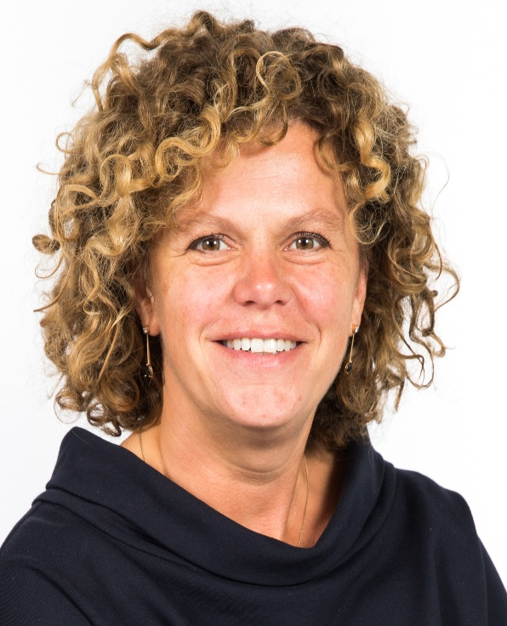
Ria Slingerland & Linda Mertens
Rotterdam University of Applied Sciences (Rotterdam Business School) - ND Rotterdam
Design-Thinking for Future Business Leaders
Ria Slingerland
Course Objective:
1. Leaning and working with the principles of design-thinking
2. Gaining a prototyping mindset
3. Applying build-measure-learn principles
3. Developing personal leadership skills
4. Developing cross-cultural sensitivity
Learning Outcomes:
At the end of this course the learner is expected to,
1. Be able to work with the principles of design-thinking,
2. Build a prototype,
3. Apply build-measure-learn principles,
3. Be aware of his/her/their personal leadership skills and desires to grow,
4. Have further developed his/her/their cross-cultural sensitivity.
2nd , 3rd, 4th year students

Slide 14

Ing. Roman Dvořák, Ph.D.
Moravian Business College Olomouc (MVŠO) - Czech Republic
Behavioral Finance: The Psychology of Investing in Modern Markets
Course Objective:
To provide students with a comprehensive understanding of behavioral finance concepts and equip them with the analytical tools to identify and mitigate psychological biases in investment decision-making.
Learning Outcomes:
  At the end of this course the learner is expected to,
  1. Distinguish between the Efficient Market Hypothesis and Behavioral Finance models.
  2. Identify key cognitive biases (heuristics, framing, emotions) affecting investors.
  3. Analyze historical and current market events through the lens of behavioral psychology.
  4. Apply behavioral techniques to construct more resilient investment portfolios.
3rd , 4th year students

Slide 15

Zdenko Metzker, Dr.
Tomas Bata University in Zlin - Czech Republic
Interactive Risk Management – From Theory to Practice
Course Objective:
The aim of the course is for students to apply risk management to a model small company in an industry of their choice and produce a coherent, practically usable deliverable: a risk register, risk prioritization, cause-and-effect analysis for key risks, a risk treatment proposal (including responsibilities and monitoring), and a basic “risk governance” setup (roles, risk owners, information flow). The course is designed as a workshop with outputs at the level of an end-to-end risk management process for the given organization
Learning Outcomes:
At the end of this course the learner is expected to,
  1. Quickly define the context and scope of the analysis and set up the basic structure of a risk register.
  2. Identify risks across categories and assess them using likelihood × impact in order to prioritize risks and identify the “top risks.”
  3. For key risks, perform a cause-and-effect analysis using an appropriate method.
  4. Propose risk treatment for the top risks and choose a 4T strategy, including the distinction between inherent and residual risk, responsibilities, timelines, and monitoring approach.
  5. Propose a simple risk governance setup for the company: risk category owners, oversight, the potential role of audit, information flow, and escalation; and be able to describe a response to a selected incident as a short “risk manual.”
3rd,4th year students

Slide 16

Ausra Turcinskaite-Balciuniene
Vilniaus Kolegija/ Higher Education Institution - Lithuanian
Creative Business Idea Development and Innovation Lab
Course Objective:
To strengthen students’ ability to generate, structure, and present innovative business ideas within a global and cross-cultural business environment.
Learning Outcomes:
  At the end of this course the learner is expected to,
  1. Identify and critically assess customer needs and market opportunities.
  2. Apply structured ideation techniques to generate innovative business solutions.
  3. Develop a coherent business model using the Business Model Canvas framework.
  4. Evaluate key risks, assumptions, and revenue logic of a proposed business idea.
  5. Deliver a structured and persuasive business pitch to an academic or professional audience.
2nd, 3rd year students

Slide 17
Saloua El Moussaoui
Artevelde University of Applied Sciences - Belgium
Global Tax Issues in an International Economy
Course Objective:
The objective of this course is to provide students with a clear and practical understanding of the main principles of international taxation and the major global tax challenges affecting businesses and governments. The course aims to help students: Understand how cross-border income is taxed, Identify key global tax problems and policy debates, Analyze
the impact of taxation on international business decisions, Develop critical thinking about fairness and efficiency in global taxation.
Learning Outcomes:
  At the end of this course the learner is expected to,
  1. Explain the basic principles of international taxation.
  2. Distinguish between residence-based and source-based taxation.
  3. Understand the purpose and functioning of double tax treaties.
  4. Identify major global tax issues such as tax competition, tax havens, and digital taxation.
  5. Describe current international tax reforms, including the global minimum tax.
  6. Apply basic tax concepts to simple international business scenarios.
3rd,4th year students

Slide 18

Wim DE BRUYN
Artevelde University of Applied Sciences - Belgium
The European Architecture of Law and Rights
Course Objective:
The objective of the course is to give students an introduction into European Institutions by teaching them about the European Union and the Council of Europe and pointing out the differences between those two.
Learning Outcomes:
  At the end of this course the learner is expected to,
  1. To know the difference between the EU and the Council of Europe
  2. Know the important institutions of these organizations
  3. Point out how the EU and the Council of Europe contribute to judicial protection
2nd,3rd,4th year students

Slide 19
IW Course Hours ( 5th,6th,7th May)
  5th May 2026, Tuesday 13.00- 16.00
  6th May 2026, Wednesday 09.30- 12.15
  7th May 2026, Thursday 10.00- 12.45

Slide 20
Thank you.
QUESTIONS?
isinsu.atalay@deu.edu.tr

